Slide 1
The Heart of PD
It’s about the mission, not the money!
It’s about the giver, not the gift.

Slide 2
Philippians 4:17
“Not that I seek the gift itself, but I seek for the profit which increases to your account.” [NASB]

Slide 3
Philippians 4:10
“I rejoiced in the Lord greatly, that now at last you have revived your concern for me; indeed, you were concerned before, but you lacked opportunity.” [NASB]

Slide 4
Philippians 4:14
“You have done well to share with me in my affliction.” [NASB]

Slide 5
Philippians 4:15
“You yourselves know, Philippians, that at the first preaching of the gospel, after I departed from Macedonia, no church shared with me in the matter of giving and receiving but you alone.” [NASB]

Slide 6
Philippians 4:16
“Even in Thessalonica you sent a gift more than once for my needs.” [NASB]

Slide 7
Philippians 4:17
“Not that I seek the gift itself, but I seek for the profit which increases to your account.” [NASB]

Slide 8
Philippians 4:17
“Not that I seek the gift itself, but I seek for the profit which increases to your account.” [NASB]
Paraphrase: Don’t misunderstand, Philippians, my desire is not for your gifts, but rather for great spiritual dividends in the lives of those who give.

Slide 9
Philippians 4:17
Key idea: What motivated the Apostle Paul in receiving gifts from his supporters was their spiritual growth.

Slide 10
Biblical Partnership Development
Biblical PD is prayerfully asking people to help meet the financial needs of our ministry for the sake of their growth into Kingdom partners.

Slide 11
Biblical Partnership Development
Biblical support development seeks partners who will join us financially – in order to help fulfill the Great Commission!

Slide 12
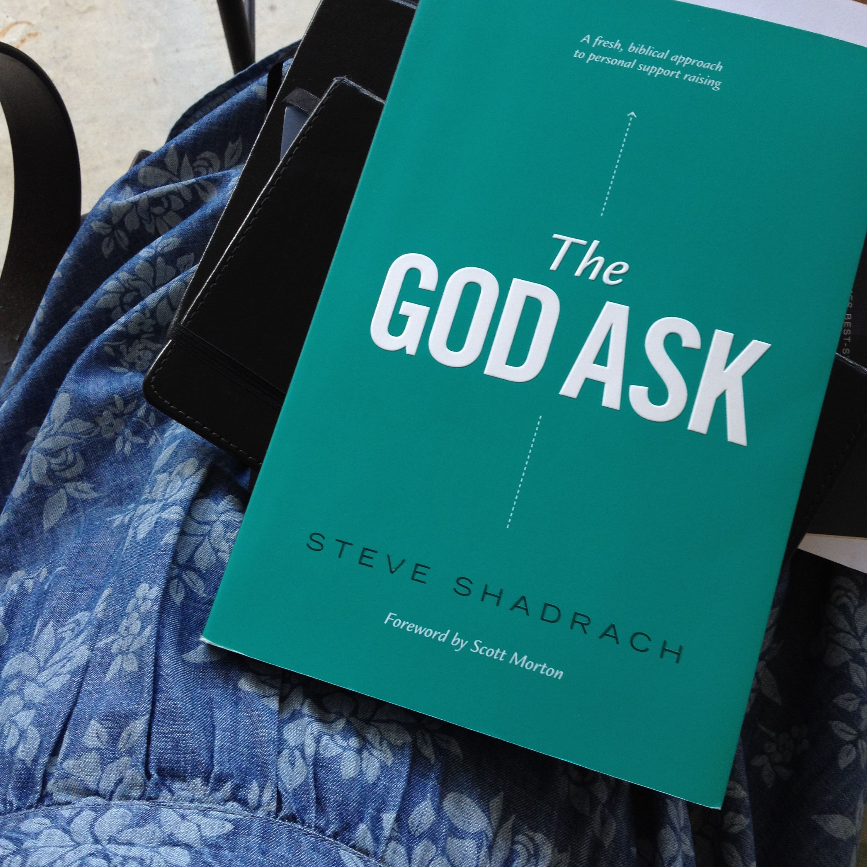
Our guiding text is God’s Word, but we also employ Steve Shadrach’s book, The God Ask.

Slide 13
“What if you were to start viewing yourself as a mobilizer? Not just moving people’s finances from one bank to another, but moving their hearts from a temporal focus to an eternal one.”
Steve Shadrach
The God Ask (p. 84)

