Slide 1
Partnership Development Overview
Ten Steps
Notes:
Gordy Welcome to this overview of the Partnership Development (PD) process.
Jeff During past NSO sessions these ten steps emerged as the best way to overview the entire process for new ISI staff raising support. In subsequent videos, we will go into greater detail on much of what is presented in this video.

Slide 2
1. prayer
The P in PD reminds us that our #1 partner in the PD journey is God Himself!
Notes:
Gordy Any brief comments you want to make on the importance of prayer to PD. This slide is ‘your baby.’

Slide 3
2. Biblical perspective
“The thing that will make you or break you will be whether or not you have really studied the Scriptures and gained a rock-solid conviction that continuing to personally ask others to invest in you and your ministry is good, is right, and is biblical.” —The God Ask (p. 58)
Notes:
Jeff Steve Shadrach puts it well in our text, The God Ask. Read Steve’s quote. We will be circling back to this important step in another video.

Slide 4
3. Record-keeping
Keeping track of all aspects of your PD.
Notes:
Gordy This slide is yours for any brief comments.

Slide 5
4. Identifying prospects
Past experience tells us that you will need at least 100 potential supporters to reach a part-time budget and at least 200 for full-time.
Notes:
Jeff As you begin to reach out to potential team members, the process starts here, identifying as big a list of potential contacts as you can find. We will provide more ideas in another video. But begin now to write down names and contact information for all the potential team member you can think of. Read slide.

Slide 6
5. Making contact
Potential supporters need to know ahead of time that you intend to ask them for financial support.
Notes:
Gordy Back to you on this one.

Slide 7
6. Requesting an appointment
Asking for a face-to-face meeting (in-person or virtual) during which you will ask for financial support
Notes:
Gordy A brief description of what we have in mind here, and it’s important rational (we do not want to surprise potential donors with an ask). Remember to mention that we will demo this.

Slide 8
7. Preparing your presentation
Outlining/illustrating a presentation asking friends to join you financially in a strategic and effective means of fulfilling the Great Commission
Notes:
Jeff Read slide. There are endless ways of doing this, especially depending on the context of your ask opportunity. We will be discussing some of the ideas that have worked well in another video.

Slide 9
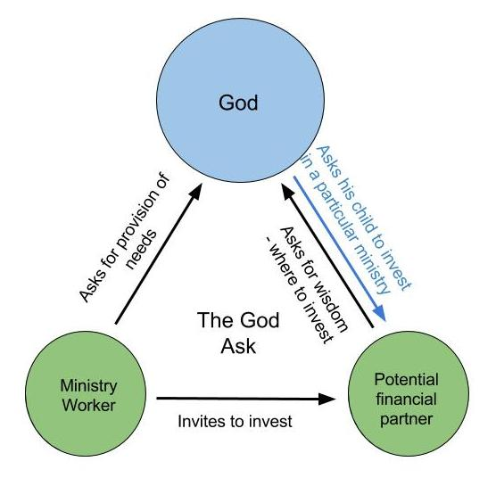
8. The God ask
Notes:
Gordy You get the ‘bid kahuna.’ This is one we may not come back to specifically, as it gets mentioned a lot. So take the time to go over all side of the triangle. Willing to make this one and others a discussion between us if you like.

Slide 10
9. Ask follow-up
Seeking an answer to your ask
Notes:
Jeff Some asks will not require a follow-up, as sometimes that it settled at the ask. If there is a norm it is that folks will want to pray about a response to your ask. In this step we talk about setting that up and then demonstrating various scenarios of how a follow-up could go.

Slide 11
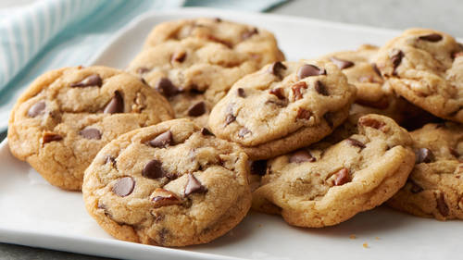
10. Donor care
This is where all the ingredients of PD bake into something really delicious and satisfying, for you and for your team!
Notes:
Gordy Your comments, briefly, about donor care, with the understanding that we will be offering much more in a future video.
Jeff WRAP: We will be coming back to many of the 10 steps in other videos. And there are other aspects of PD we will mention as well. But for now this gives you the overview from which we will be working. Remember prayer is #1. So why not take a few moments now to pray for all the aspects of your PD ahead. As you do, know that we are praying too!
Gordy Prays

