Slide 1
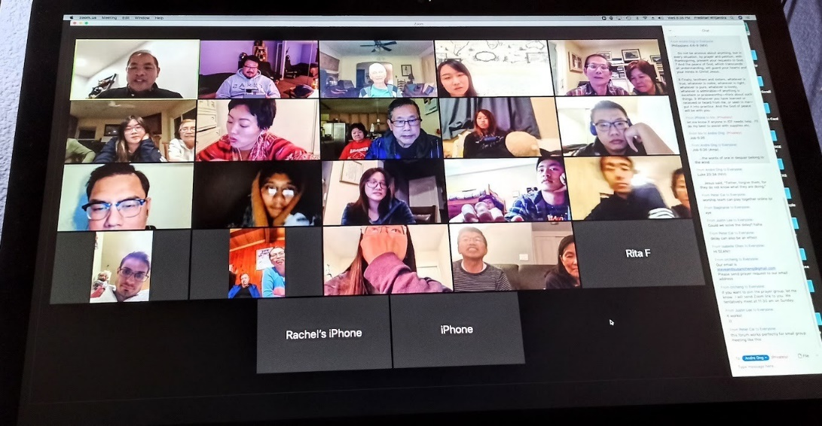
Reaching International Students During COVID

Slide 2
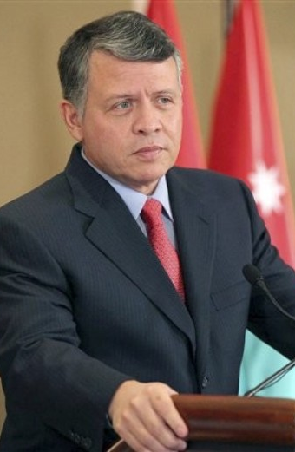
Do you know?
Nearly half the world’s heads of state were at one time international students in the US, including Jordan’s King Abdullah II.

Slide 3
Traditional Missions Model We go there

Slide 4
ISI Missions Model – Part 1 They come here

Slide 5
ISI Missions Model – Part 2 They go as missionaries to their home

Slide 6
ISI Missions Model – Part 3 We visit returnees to encourage them
Hong Kong 2011
Goa 2015
Singapore 2017

Slide 7
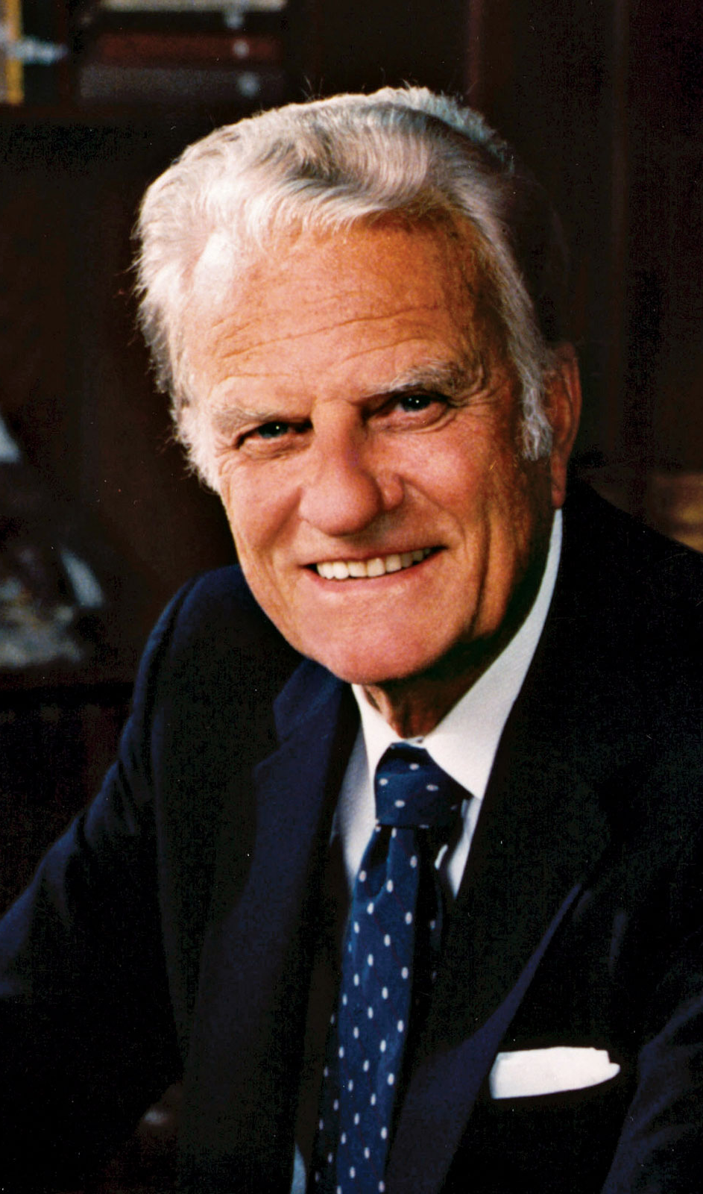
How effective is ministry to international students?
“From the standpoint of world evangelism, I believe that this approach of introducing internationals to Christ is one of the most important missionary movements in the world today.”
--Billy Graham

Slide 8
ISI’s goal is for every international student to be won to Christ and discipled to return as a Harvest worker to his or her home country. These workers . . .
Do not have to raise support
Do not have to secure a resident visa
Are often returning to the least reached countries
Are often returning to closed countries
Already know the language and culture
Already have a network of relationships.

Slide 9
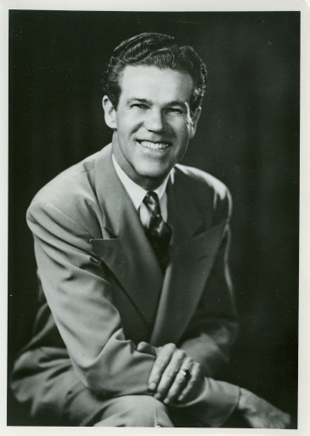
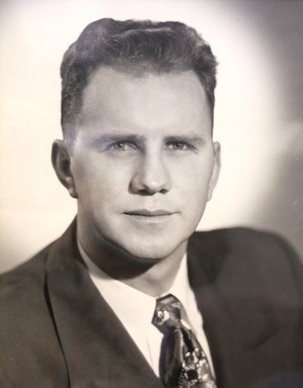
So how did all this begin?
In 1951, Dawson Trotman, founder of The Navigators, spoke with Bob Finley about an outreach to foreign students arriving to study in the US.
Soon, others joined Bob Finley in the work and ISI was founded in 1953.

Slide 10
ISI Exists to . . .
. . . share Christ's love with international students and to equip them for effective service in cooperation with the local church and others.

Slide 11
Today . . .
Nearly 400 staff & Ministry Representatives, plus 24,000 volunteers, are ministering to international students on nearly a thousand campuses all across the US.
Thus the task is huge!
The task is also strategic!

Slide 12
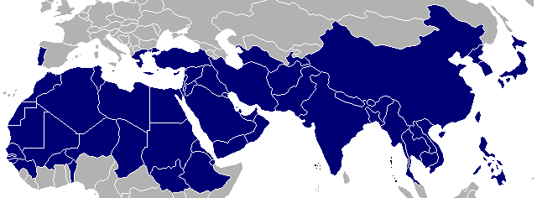
The 10/40 Window*
*The 10/40 Window is a term coined by Christian missionary strategist Luis Bush in 1990 to refer to those regions of the eastern hemisphere, plus the European and African part of the western hemisphere, located between 10 and 40 degrees north of the equator.

Slide 13
The 10/40 Window and International Students
97% of the least evangelized world resides in the 10/40 Window
Many countries in the 10/40 Window are closed to missionary access. But . . .
60% of international students are from these least evangelized, limited access countries.

Slide 14
Personalize with information about your ISI ministry . . .

