Slide 1
STEP 3 Record-keeping
Lots of Options

Slide 2
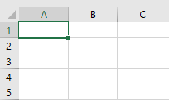
An Excel spreadsheet works well
TntWare is the ‘Cadillac’
Note everything you can think of about each contact

Slide 3
STEP 4 Identifying Prospects
Your Personal Contact List (PCL)

Slide 4
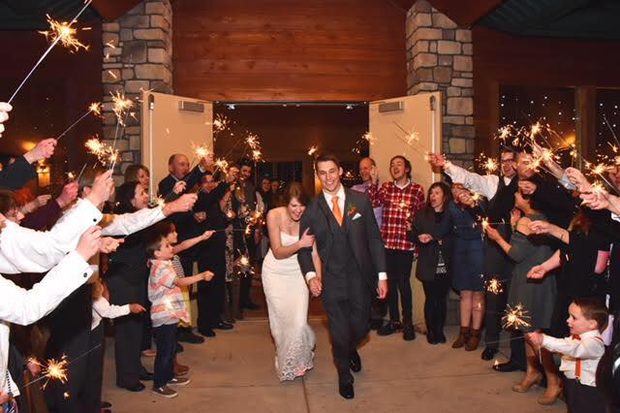
“Have as large a wedding as possible. You’ll never know when it will come in handy!” —The God Ask (p. 152)

Slide 5
‘Namestorming’ Steps
Pray, asking God to help you remember.
Write down everyone you can possibly think of that you ever knew or met.
There are no bad names!
The average person has about 1,000 friends and acquaintances.
But the average person has kept up with only 60 of those.

Slide 6
‘Namestorming’ Ideas
Yearbooks
Wedding invitation lists
Christmas card lists
Church directories
Accumulated pictures
Facebook friends
Cell phone contacts

Slide 7
Finding info on old contacts
The God Ask (p. 332)
AnyWho.com
ZabaSearch.com
Google Maps

Slide 8
Organizing
Segmenting your PCL:
A LIST: ASK to partner in the vision
B LIST: BRING awareness of the vision
C LIST: CONNECT with acquaintances

