Slide 1
Organizational & Management Structures
November 2020
Alex Tovar
Director of Operations

Slide 2
Directors
INTERNATIONAL STUDENTS, INC. ORGANIZATIONAL CHART
*Also serves as City Director Phoenix & Acting Director of Recruitment
Board of Trustees
(ensures financial viability and fulfillment of ISI’s mission)
Seng Tan
President/CEO
Regional Field Directors
(manage and provide pastoral care for staff members in their region)
Gordy Decker
National Training Director
(develops and delivers ISI-specific training for staff, ministry partners, and students)
Teri Crowell
National
Director of
Recruitment (part-time)/
Assistant
Training
Director
(part time)*
(recruiting and oversight of applications for field ministry)
Alex Tovar
Director of
Operations
(oversees operations of the ministry including finance, personnel, insurance, employee benefits, IT, special projects, etc.)
Roger Martin
Global Pastor
(provides pastoral care for ISI’s global team)
Jeff Townsend
Director of Field Development
(train, coaches, and monitors Partnership Development of field team members who raise support)
Derrah Jackson
Director of
Research and
Innovation
(finds new, fresh, and innovative ways to keep the ministry moving forward)
David Larson
Regional Field Director
(Northeast Region)
Roy Yabuki
Regional Field Director
(Rocky Mt. /Plains Region)
Ed Germann
Regional Field Director
(Southeast/Great Lakes Region)
Simon Zeigler
Regional Field Director
(Western Region)

Slide 3
Board of Trustees
Mr. Vic Evans
Mr. Steve Heinz
(Chair)
Mr. Keith Jordan
Mrs. Sandi King
Mr. Denny Schlosser
Dr. Seng Tan
(President/CEO)
Mark Waters

Slide 4
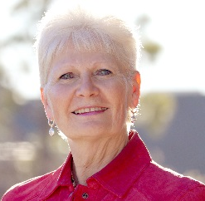
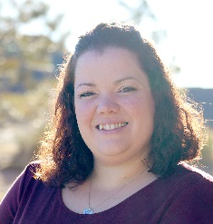
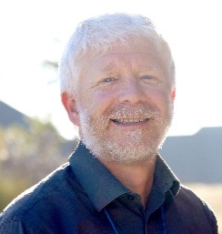
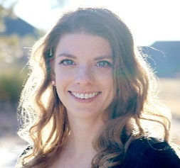
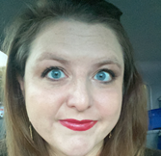
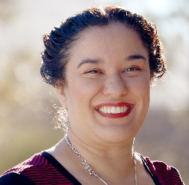
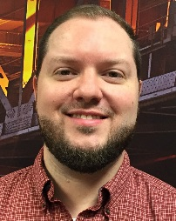
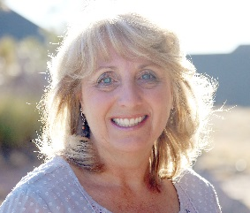
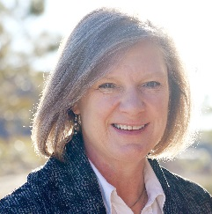
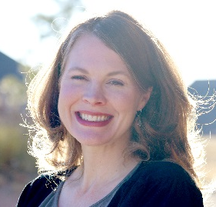
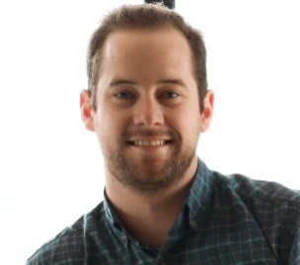
ISI Operations Team
Ministry Advancement
Finance
Ministry Operations
Christine
Breanne
Sheldon
Jennifer M.
Mickie
Sarah
People Services
Publications/Websites
Kassania
Jonathan
Teresa
Jennifer L.
Rebekah
Austin

Slide 5
FY 19-20 Strategic Plan
Ensure that prayer, dependence and surrender to the Lord characterize everything we do.
Accelerate and strengthen our field ministry efforts—campus, city, church, and special interest groups.
Ensure all systems, relationships, and safeguards are in place for maximum effectiveness of returning international students.
Recruit, train and equip all staff to minister in confidence, competence and effectiveness.
Ensure that the ISI National Ministry and all ISI staff, volunteers and ministry partners are resourced and supported for maximum ministry effectiveness.
Secure a permanent, debt-free international headquarters for the organization and ministry.

Slide 6
What We Believe
Mission Statement:
International Students, Inc. exists to share Christ's love with international students and to equip them for effective service in cooperation with the local church and others.
Core Values:
Christ-centered approach to serving others
Student-centered ministry
Full-cycle evangelism
Dependence on churches
National identity
Statement of Faith and Biblical Principles:
Final Authority: the Bible speaks with final authority concerning truth, morality, and conduct
Marriage: the uniting of one man and one woman in a single exclusive union (Gen 2:18-25)
Gender: God wonderfully and immutably creates each person as male or female that reflect the image of God (Gen 1:26-17)
Sexuality: God intends sexual intimacy to occur between a man and woman who are married to each other (1 Cor 6:18)
Sanctity of Life: we are called to defend, protect, and value all human life (Ps 139)

Slide 7
Social Media Policy and Best Practices
No names and locations of international students
You MUST have written permission. If you do not have permission, DO NOT POST their name/location. Use ISI’s Media Release Form to document the student’s permission
Because “…it should be considered that any and all communications via such media is representational of ISI unless the communications clearly state that they are being offered purely in a personal capacity”, please note that “Liking” (Facebook) or “Promoting/Favorite” (Twitter) articles on Social Media networks may be construed as ISI’s endorsing a cause, organization and/or person that may stand for something in direct violation of our Statement of Faith, Mission, Vision and/or Core Values. As such, please exercise prejudice before “liking” or “promoting” articles online.
Do not post negative comments.

Slide 8
Ministry Operations
www.isiministryoperations.org
Legal & Insurance
Contracts
Liability insurance
Social Media Policy
Music/Video Use
Student Event Photos
Overseas Trips
Reporting

Slide 9
Questions?

