Slide 1
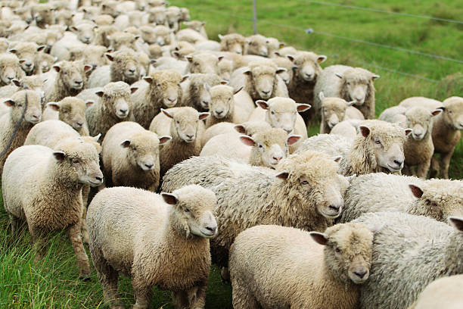
STEP 10: Donor Care
Nurturing your flock

Slide 2
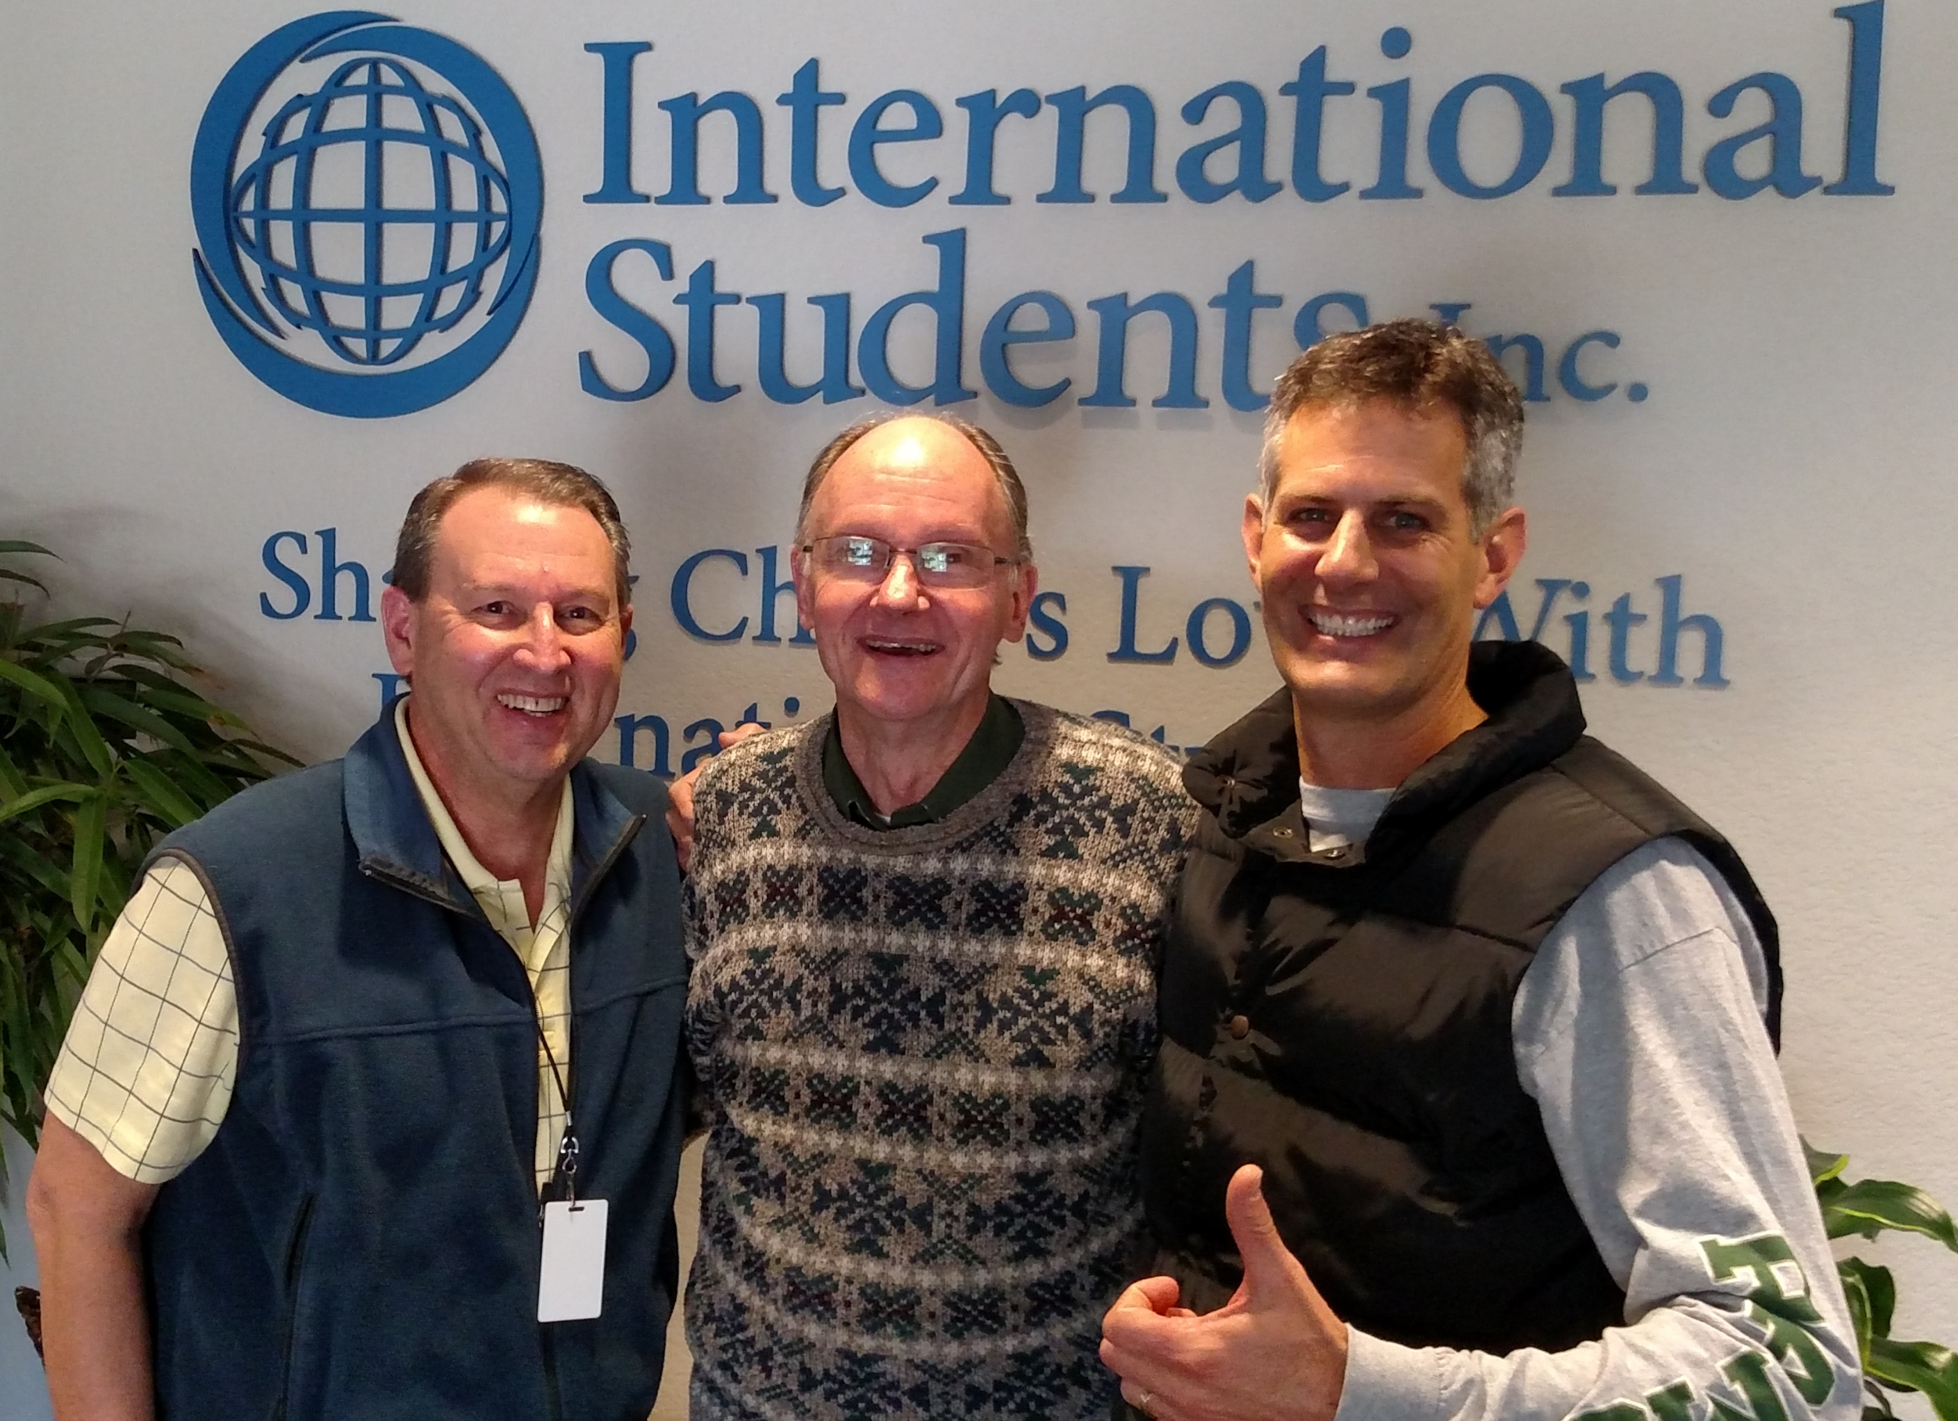
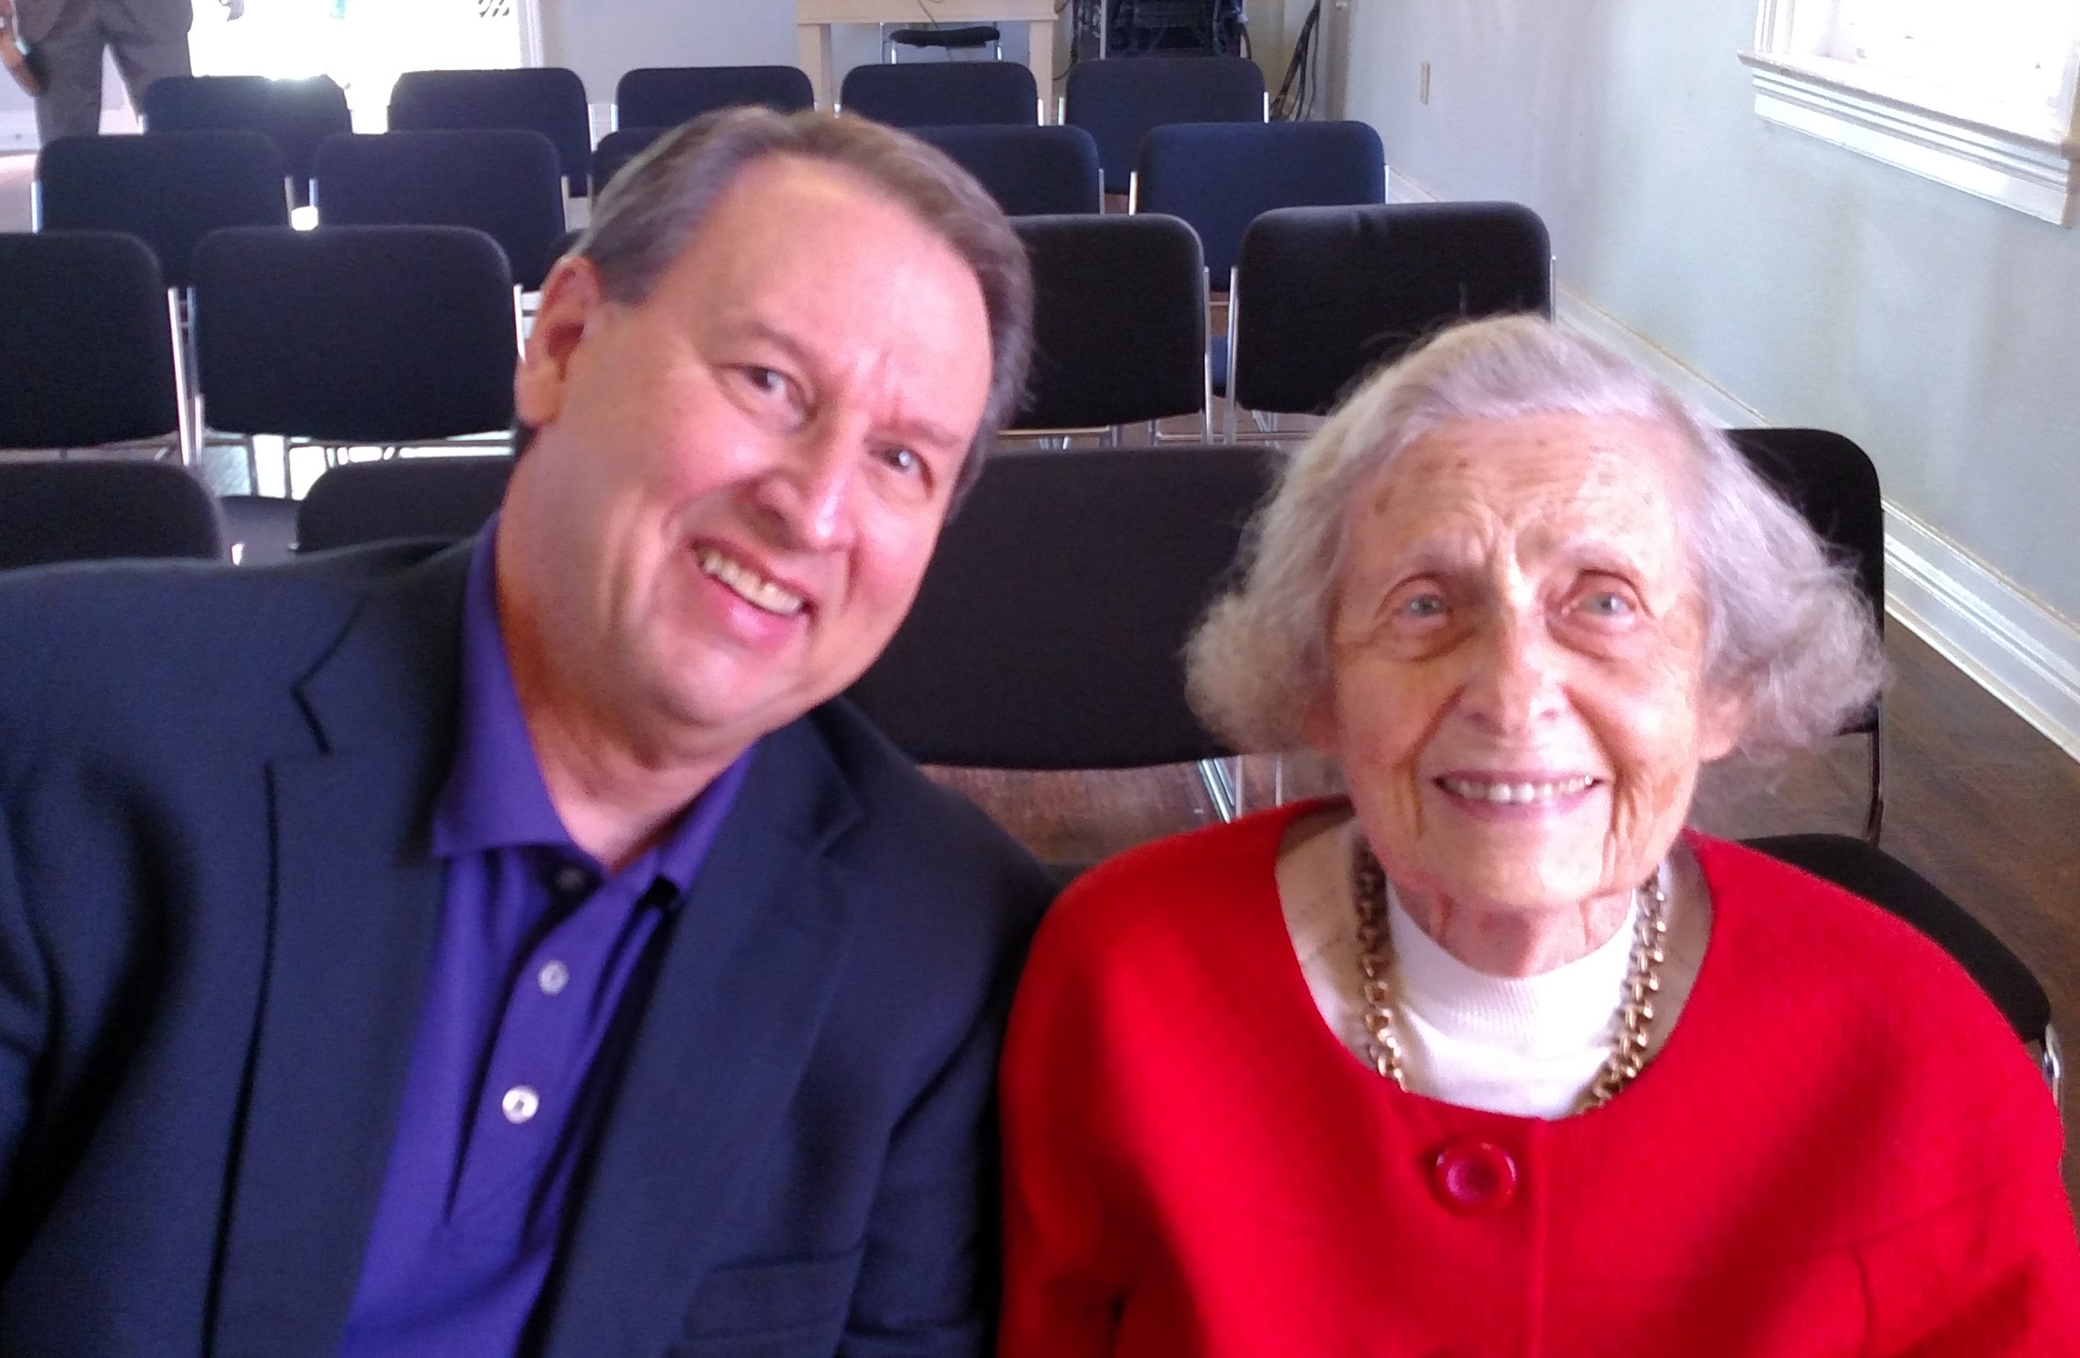
Get to know them (record in your record-keeping tool)
Their preferred names
Birthdays and anniversary
Children’s names and birthdays
Pets and their names
Other unique details and preferences

Slide 3
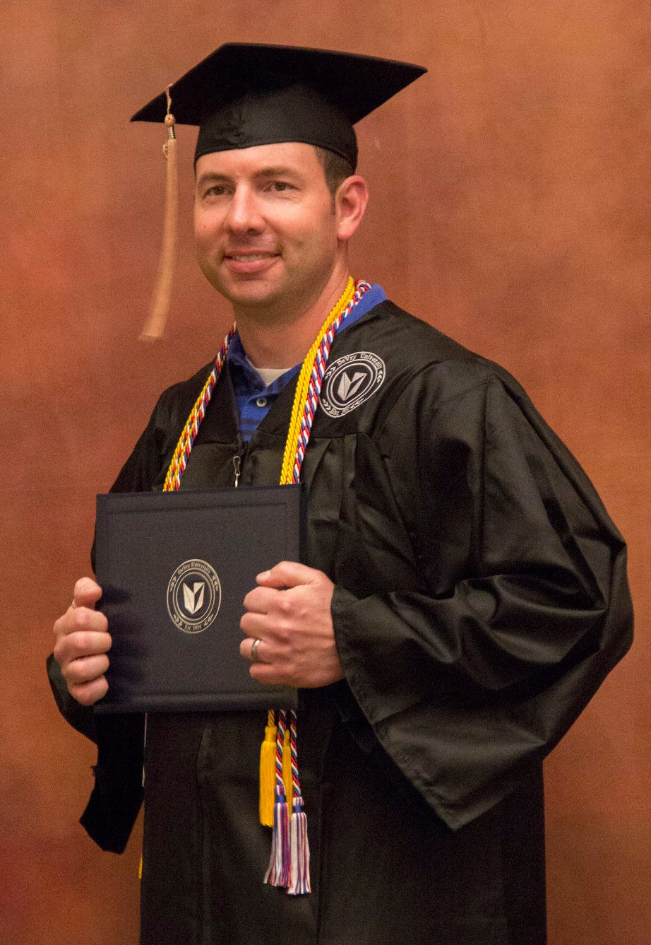
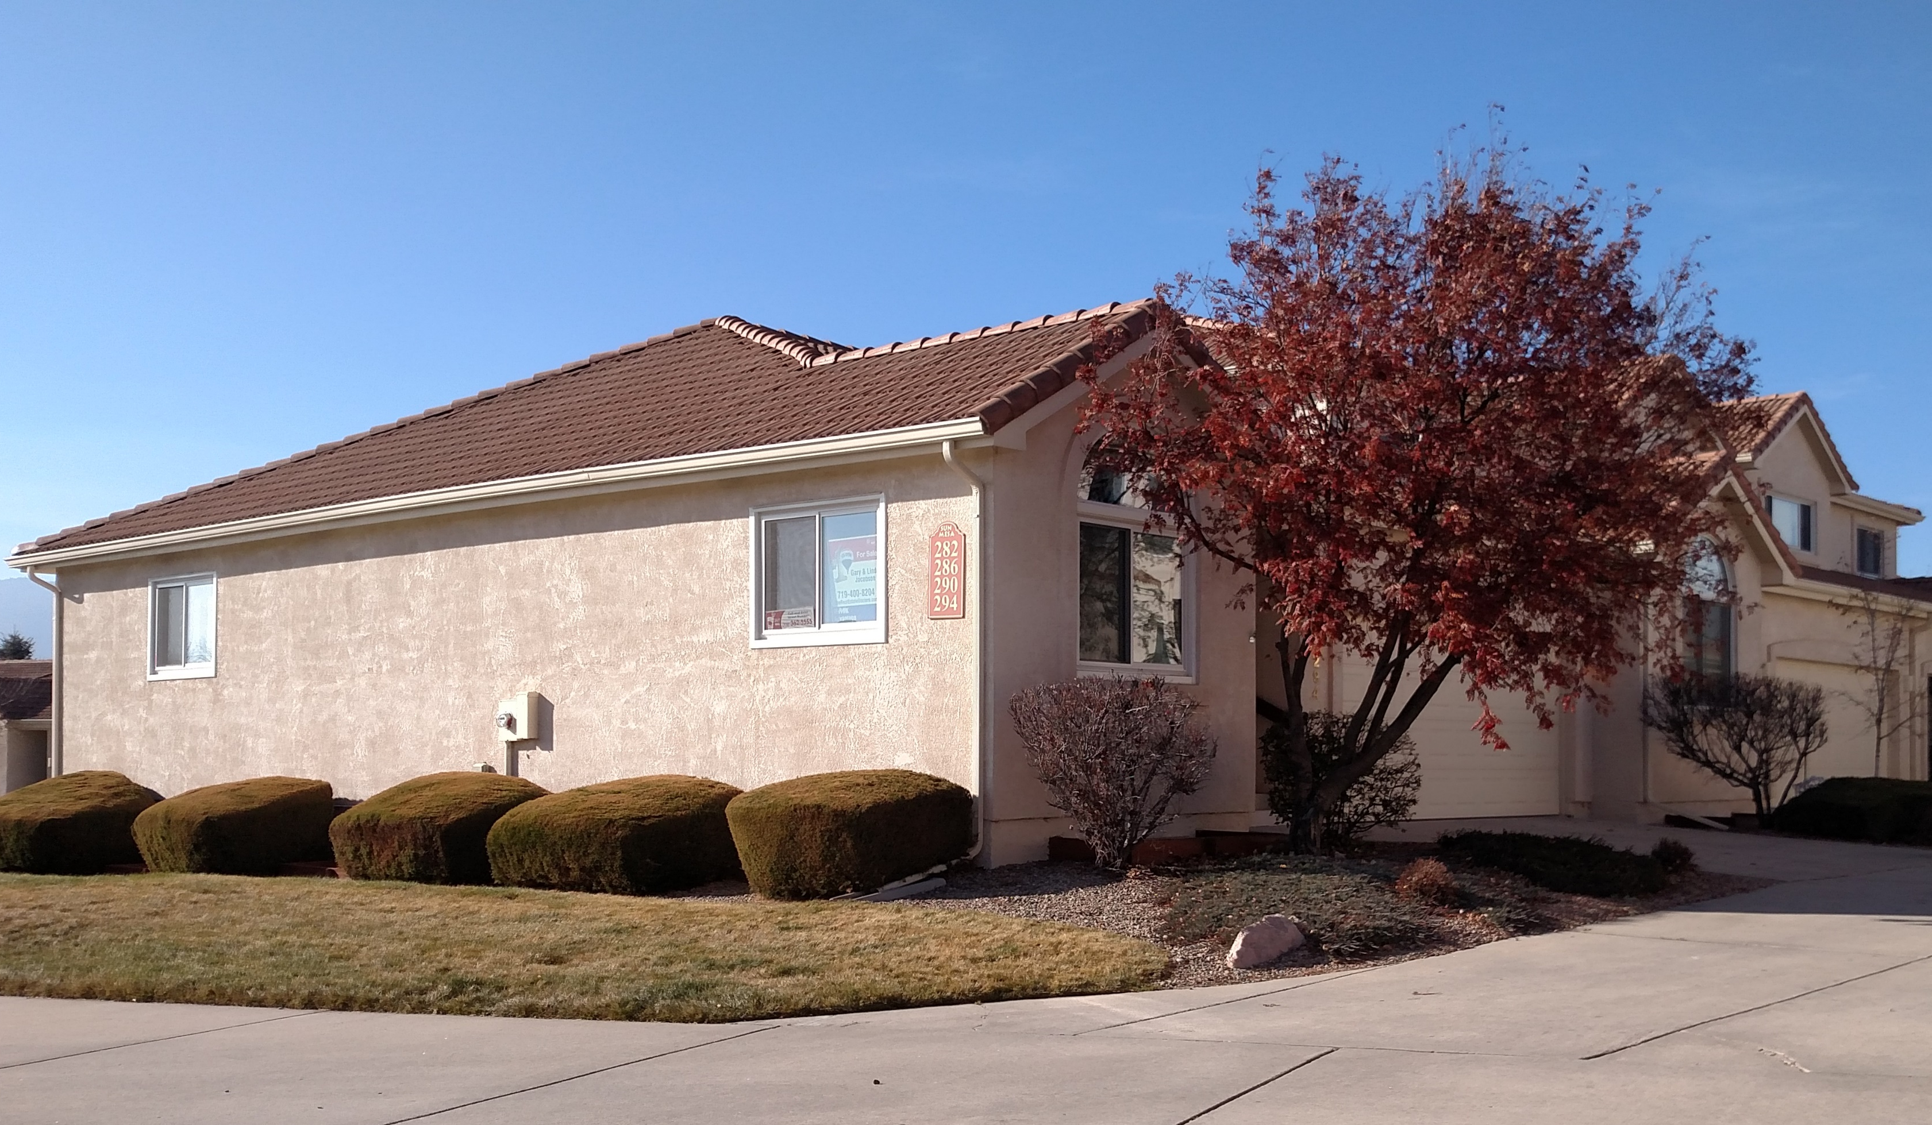
Correspond with them
Regular updates on ministry; prayer needs
Births; birthdays
Wedding; wedding anniversary
Kid birthdays
Significant accomplishments; events
Important dates

Slide 4
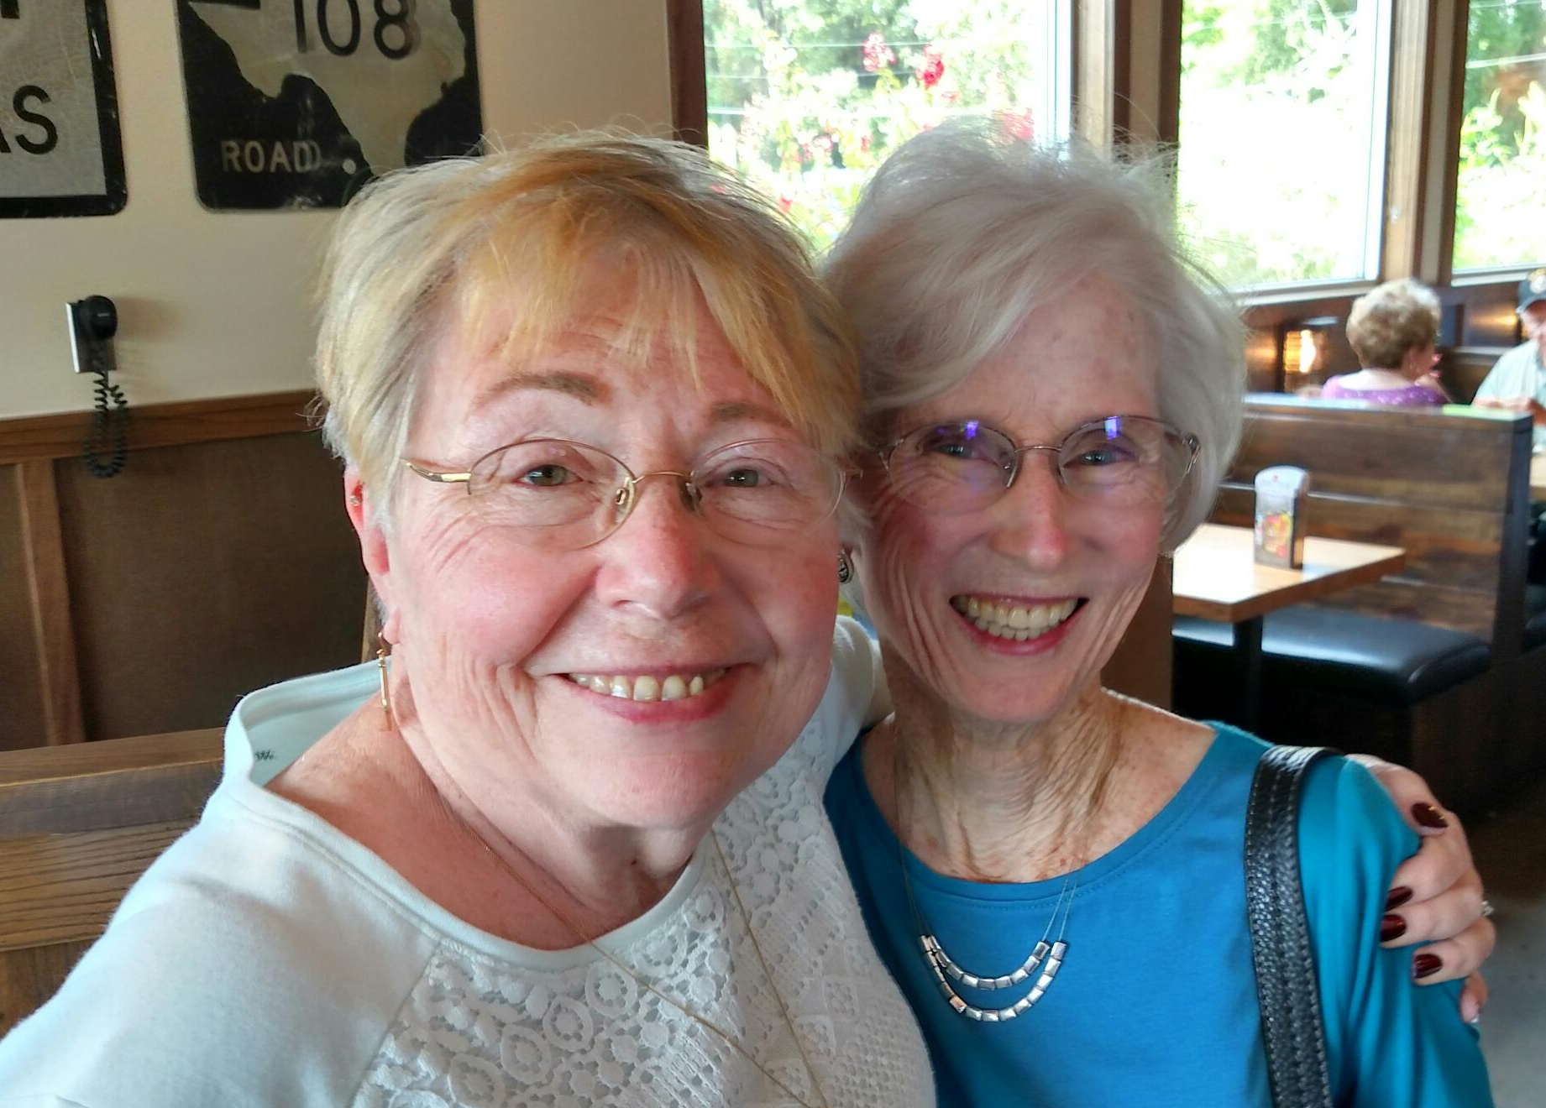
Meet/Visit them
Meet regularly with local supporters
Regularly plan PD travels to more distant supporters
Build in ‘ask’ visits on your travels
Be sure to leave your latest ‘mag-card’
Keep records of all meetings/visits
Build in vacation time
www.creativeplus.com

Slide 5
Involve them
Pikes Peak Area Wild West Welcome

Slide 6
Thank them
Always nice to do this via mailed, hand-written card
Every once in a while, a small gift is appropriate
I always leave a gift on PD travels
www.christianbook.com is a good resource for gifts
Be sure to record gifts given

