Slide 1
DISC

Slide 5
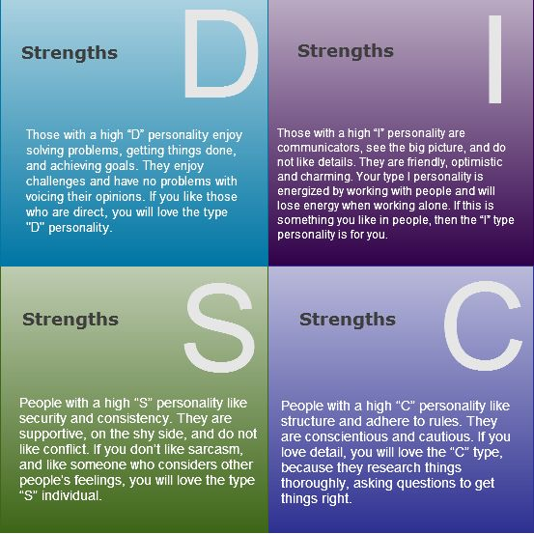

Slide 9
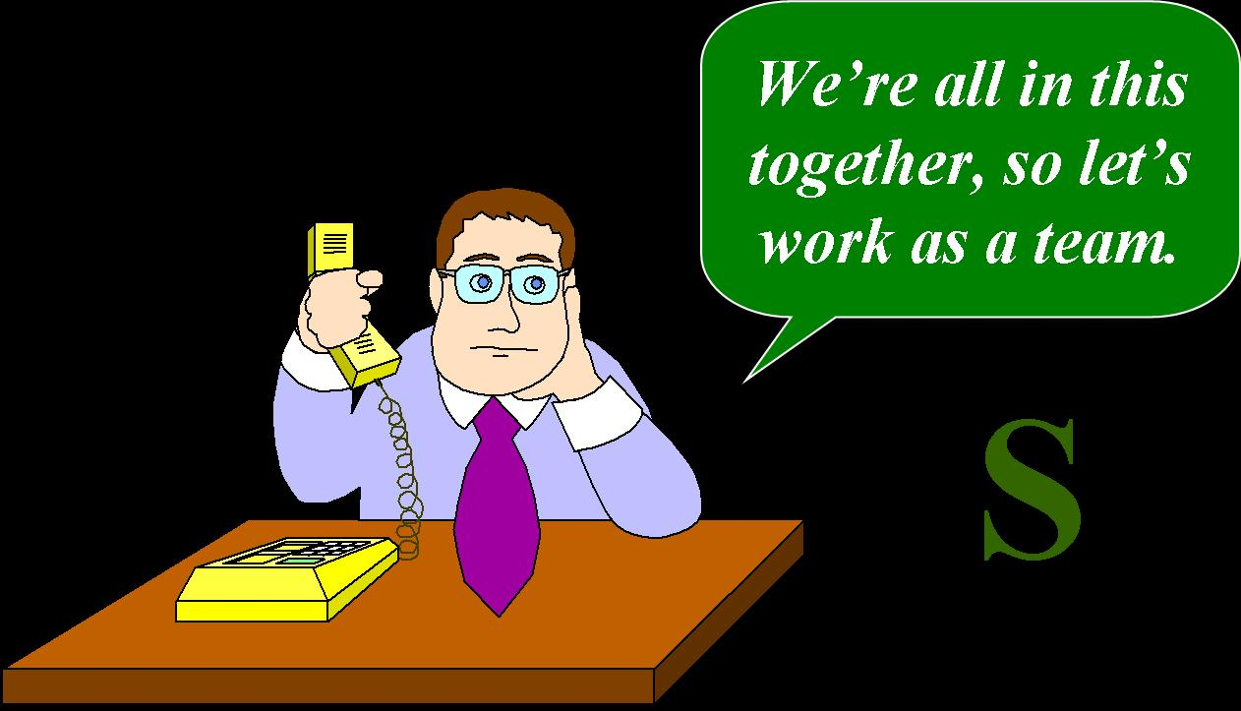

Slide 10
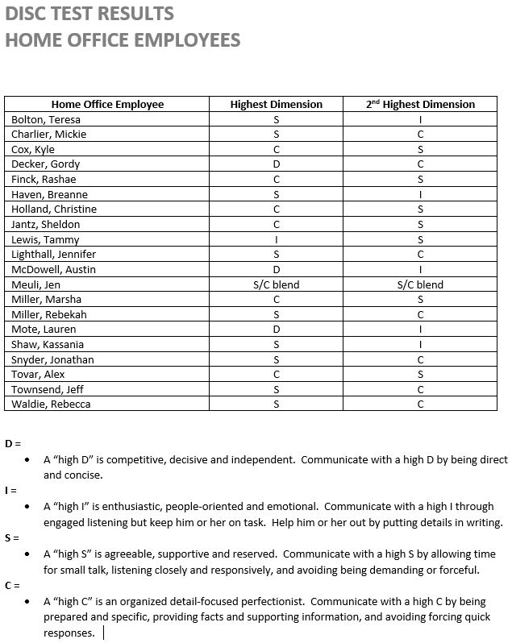

Slide 16
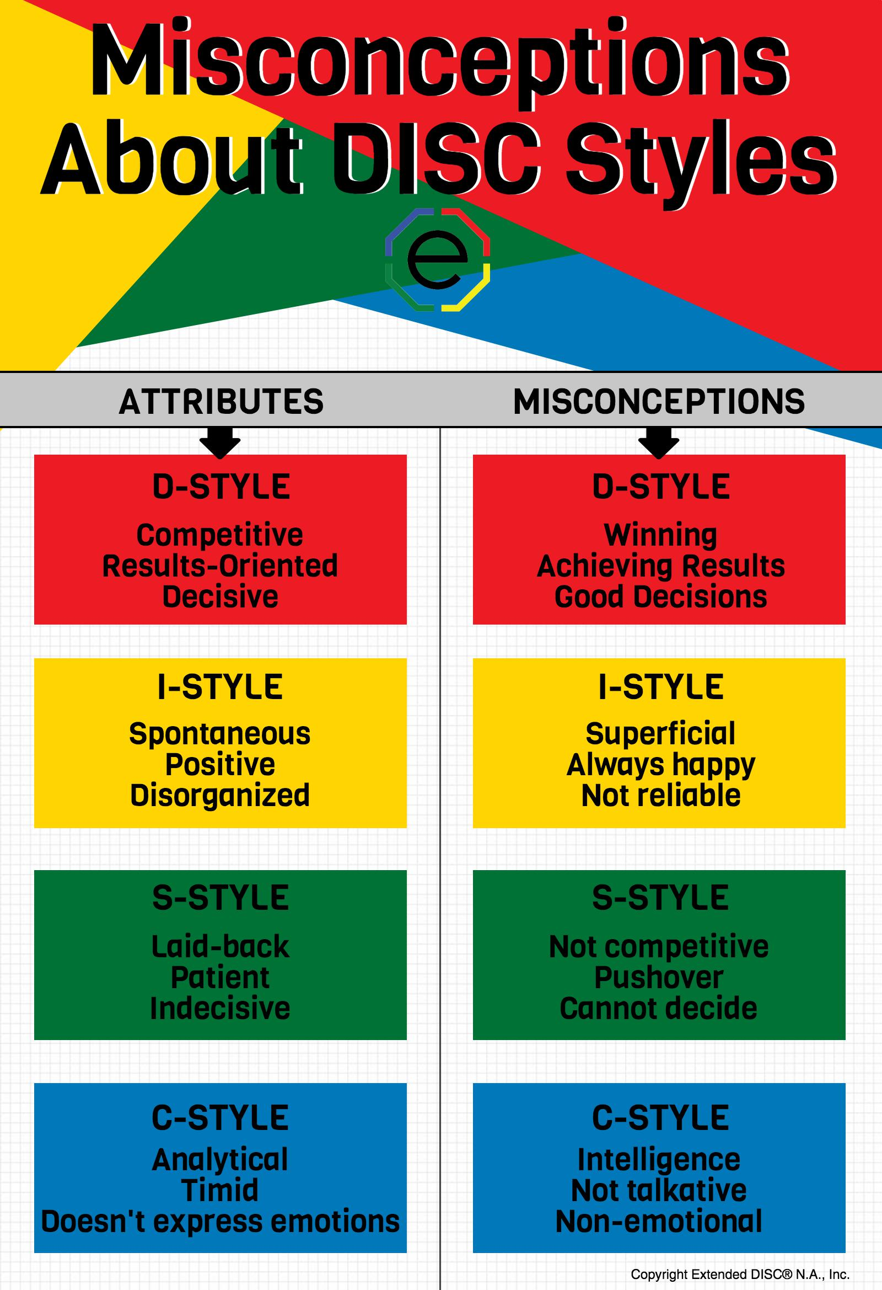

Slide 17
1Corinthians 12
1 Now concerning spiritual gifts, brethren, I do not want you to be unaware…
4 Now there are varieties of gifts, but the same Spirit. 5 And there are varieties of ministries, and the same Lord. 6 There are varieties of effects, but the same God who works all things in all persons. 7 But to each one is given the manifestation of the Spirit for the common good.

Slide 18
12 For even as the body is one and yet has many members, and all the members of the body, though they are many, are one body, so also is Christ.
14 For the body is not one member, but many. 15 If the foot says, "Because I am not a hand, I am not a part of the body," it is not for this reason any the less a part of the body. 16 And if the ear says, "Because I am not an eye, I am not a part of the body," it is not for this reason any the less a part of the body. 17 If the whole body were an eye, where would the hearing be? If the whole were hearing, where would the sense of smell be?

Slide 19
18 But now God has placed the members, each one of them, in the body, just as He desired. 19 If they were all one member, where would the body be? 20 But now there are many members, but one body. 21 And the eye cannot say to the hand, "I have no need of you"; or again the head to the feet, "I have no need of you." 22 On the contrary, it is much truer that the members of the body which seem to be weaker are necessary; 23 and those members of the body which we deem less honorable, on these we bestow more abundant honor, and our less presentable members become much more presentable, 24 whereas our more presentable members have no need of it.

Slide 20
But God has so composed the body, giving more abundant honor to that member which lacked, 25 so that there may be no division in the body, but that the members may have the same care for one another. 26 And if one member suffers, all the members suffer with it; if one member is honored, all the members rejoice with it…
And I show you a still more excellent way. (NASB)
1Corinthians 13 LOVE

Slide 22
One BODY.

