Slide 1
DISC

Slide 4
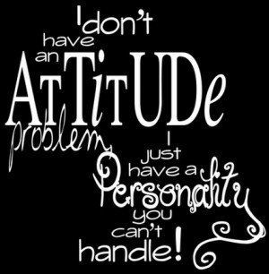

Slide 6
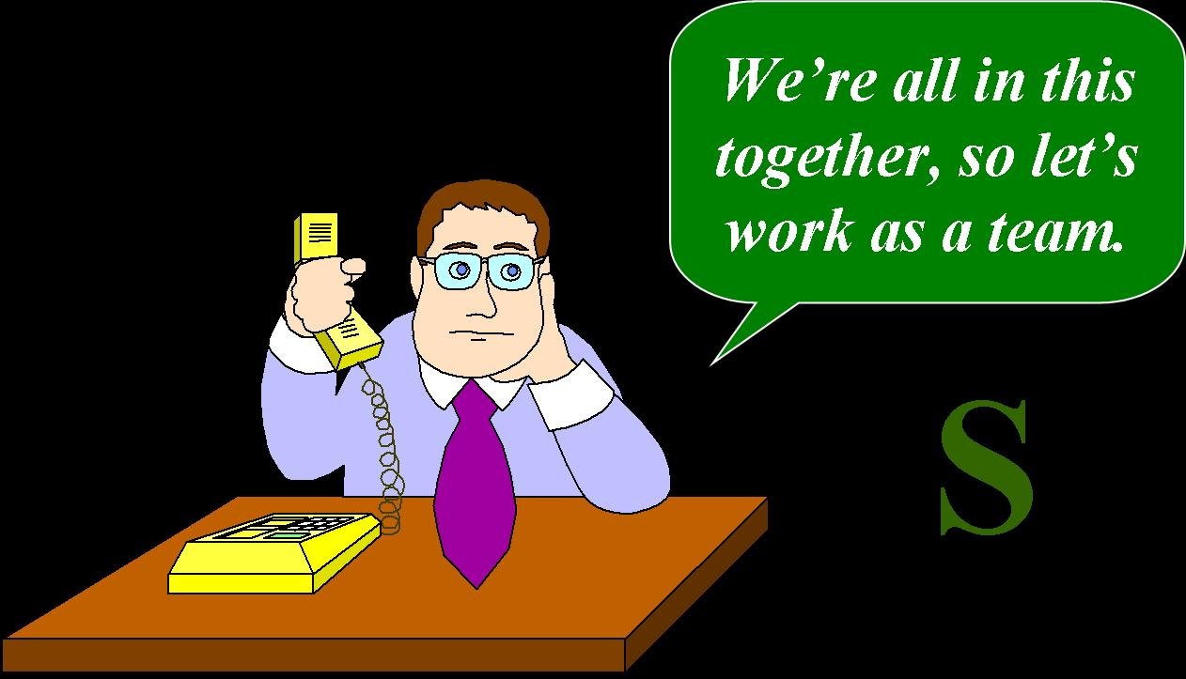

Slide 9
Notes:
How is the D.I.S.C. useful to us in our PD work? It is a tool that helps us “match the hatch.” What to I mean by that? I live in Colorado… There are different food sources for different seasons and feeding preferences of the fish in those streams and lakes. The successful fisherman knows how to read the conditions and matches the hatch with just the right artificial lure and presentation in order to catch fish. Similarly, in our PD work it is important to discern the personality type of those we are asking to prayerfully consider coming on our support team, in order to provide them with the type of information they need to make an informed decision

Slide 14
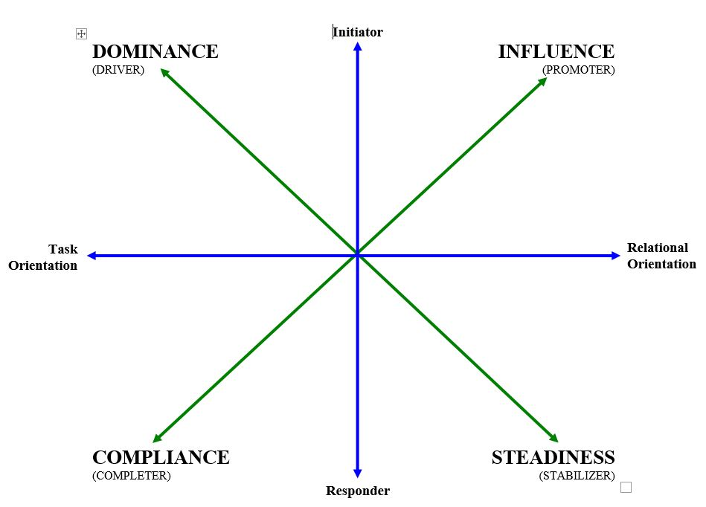
DISC Patterns
Notes:
Another way of picturing our interpersonal and/or work styles is using this graph with X and Y axes. As you can see…

Slide 15
DISC Patterns
Notes:
Each of us is a blend of two or more personality types and therefore display varying levels of characteristics depending on the mix and strength of our styles, as well as the different environments we may find ourselves. But typically, most people have one dominant and one secondary style which serves to balance out the extremes of any one personality type.

Slide 16
1Corinthians 12
1 Now concerning spiritual gifts, brethren, I do not want you to be unaware…
4 Now there are varieties of gifts, but the same Spirit. 5 And there are varieties of ministries, and the same Lord. 6 There are varieties of effects, but the same God who works all things in all persons. 7 But to each one is given the manifestation of the Spirit for the common good.

Slide 17
One BODY.

