Slide 1
DISC in PD
NSO Training
International Students, Inc.
2019
Notes:
Please leave us a 5 star rating if you love this free template!
Welcome to Super Easy Templates: This is an 8 x 11 PowerPoint design slide. We provide easy-to-use and customize templates for home and business use. Most of our templates are for PowerPoint 2007 and Word 2007. If you are interested in additional templates, visit our website: www.supereasytemplates.com. If you require technical support on this specific presentation, email us: support@supereasytemplates.com. Also, check the Microsoft forums for specialized assistance. Although we try to respond to all support requests, please realize that this is a free service and we cannot guarantee a timely response. All questions and answers are usually posted on our FAQ pages.

Slide 3
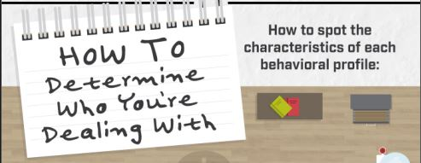

Slide 4
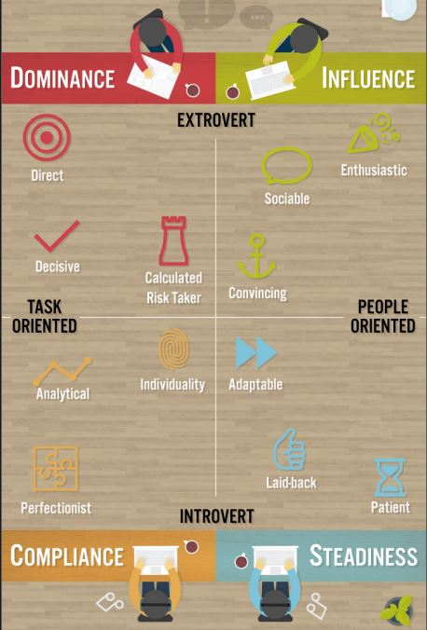

Slide 6
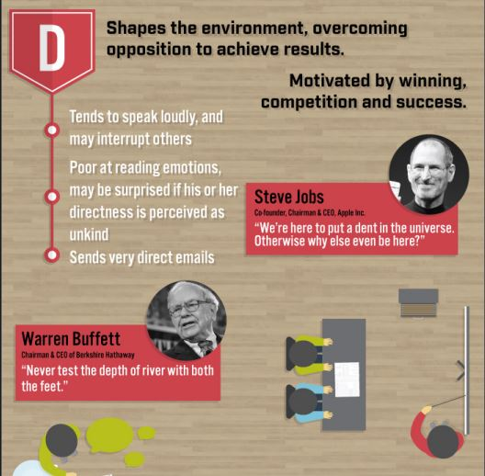

Slide 8
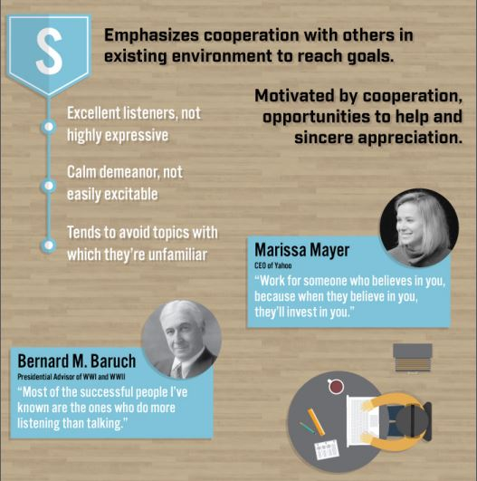

Slide 11
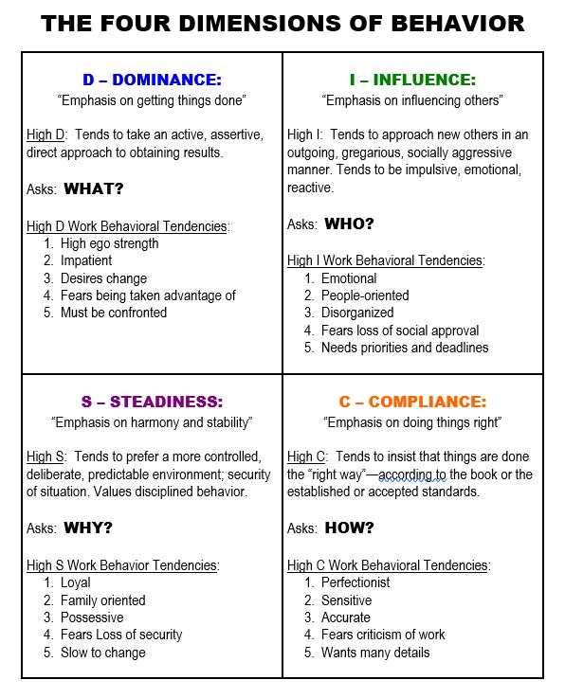

Slide 12
