Slide 1
Equipping & mentoring
Equipping God’s People to Reach and disciple the Nations at Our Doorstep.

Slide 2
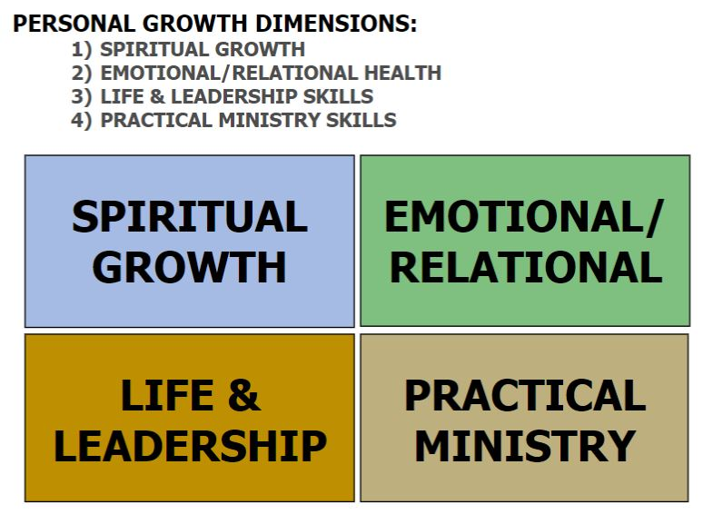
Dimensions of learning

Slide 3
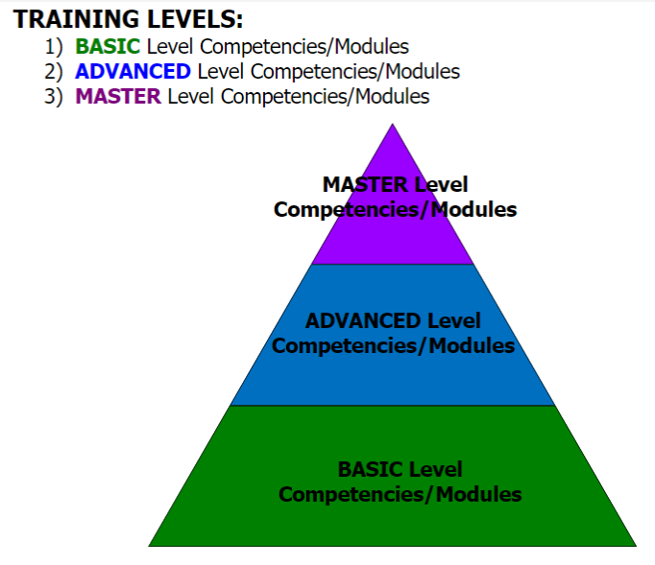
Levels of learning

Slide 4
Personal growth plan

Slide 5
Equipping initiatives
Experts On Call (EOC): Outside (of ISI) experts/professionals sharing relevant expertise with ISI staff and volunteers to assist/strengthen ISM efforts/outcomes.
Keys 2 Success (K2S): Inside (of ISI) experts sharing relevant/innovative approaches with ISI staff and volunteers in order to assist/strengthen their ISM efforts/ outcomes.
Stay tuned for upcoming EOC and K2S opportunities!
Image courtesy of Telegraph India.

Slide 6
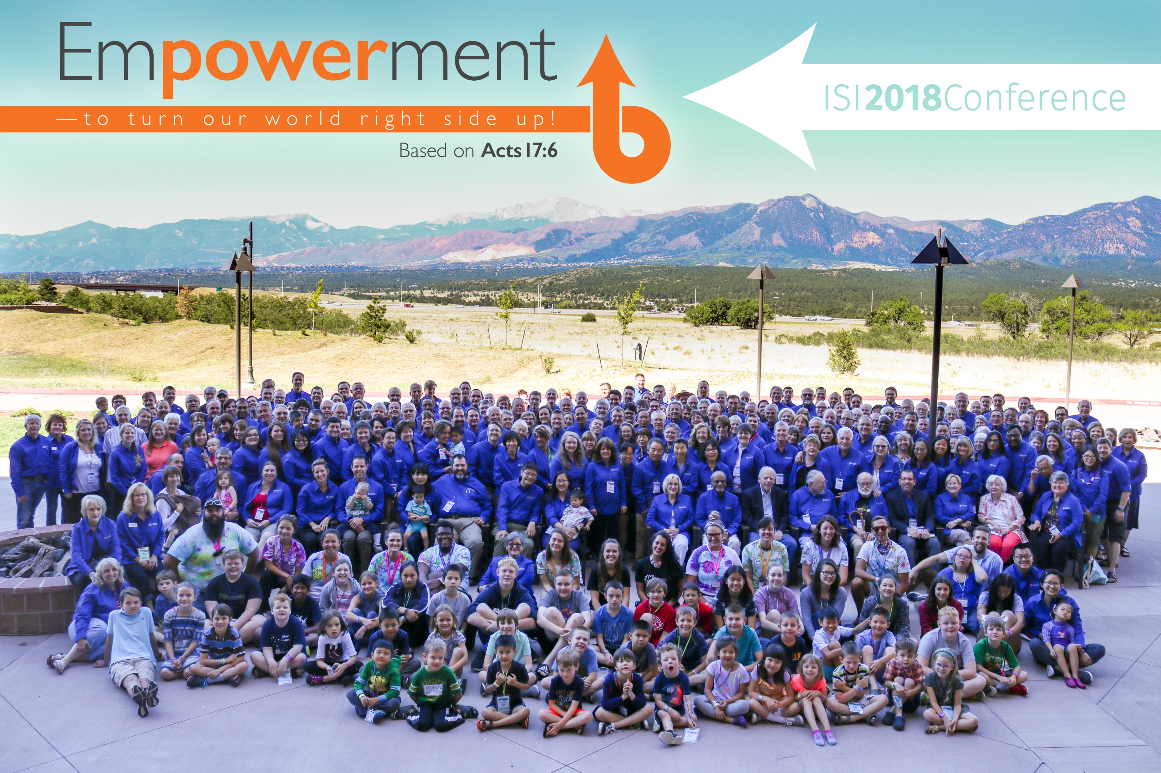
Training/equipping workshops
NATIONAL CONFERENCE
REGIONAL CONFERENCES
SPECIAL ISSUES/TOPICS

Slide 7
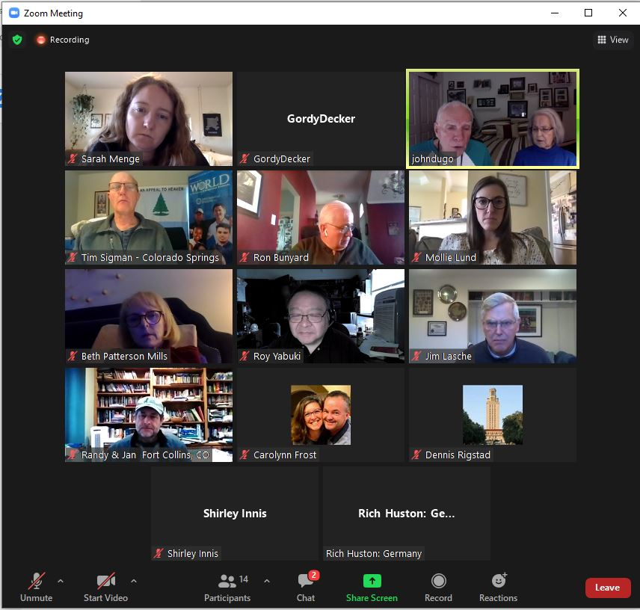
COACHING
SHORT-TERM COMMITMENT
Coaching through select modules:
Groups (cohorts)
Individuals
Coaching new staff, volunteers,
churches, ministry partners in ISM
REACH Internationals – video series
M28 Global Discipleships
TalentLMS modules

Slide 8
mentoring
LONGER-TERM COMMITMENT
Life/Ministry Mentor
Spiritual Growth
Emotional/Relational Health
Life & Leadership Development
Practical Ministry Skills
Not yet formalized (though informal mentoring continues to take place).

Slide 9
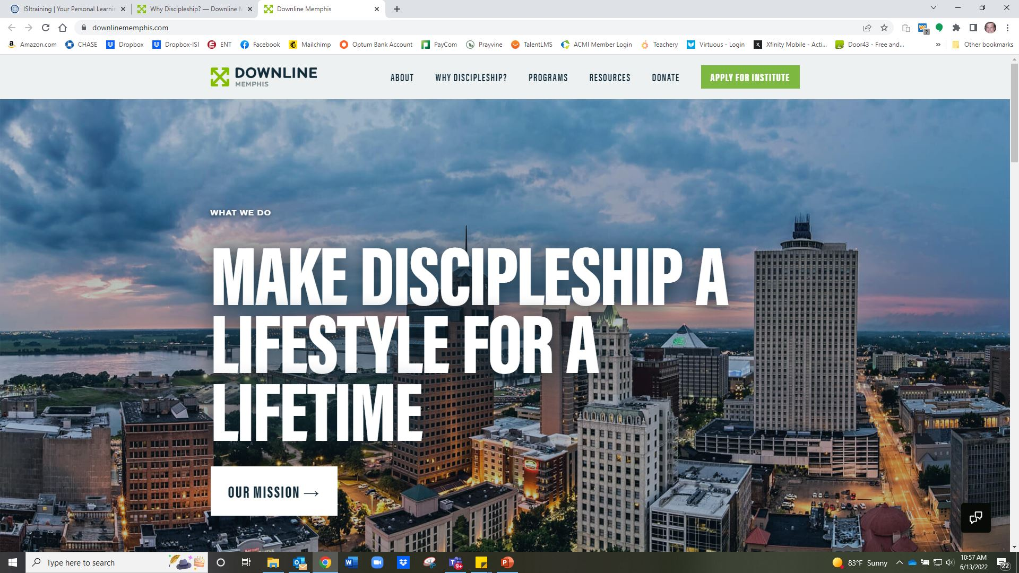
Opt opportunities
Providing international students opportunities to engage professionally while being Mentored as disciple-makers in their spheres of impact.
E.g., DOWNLINE MINISTRIES

Slide 10
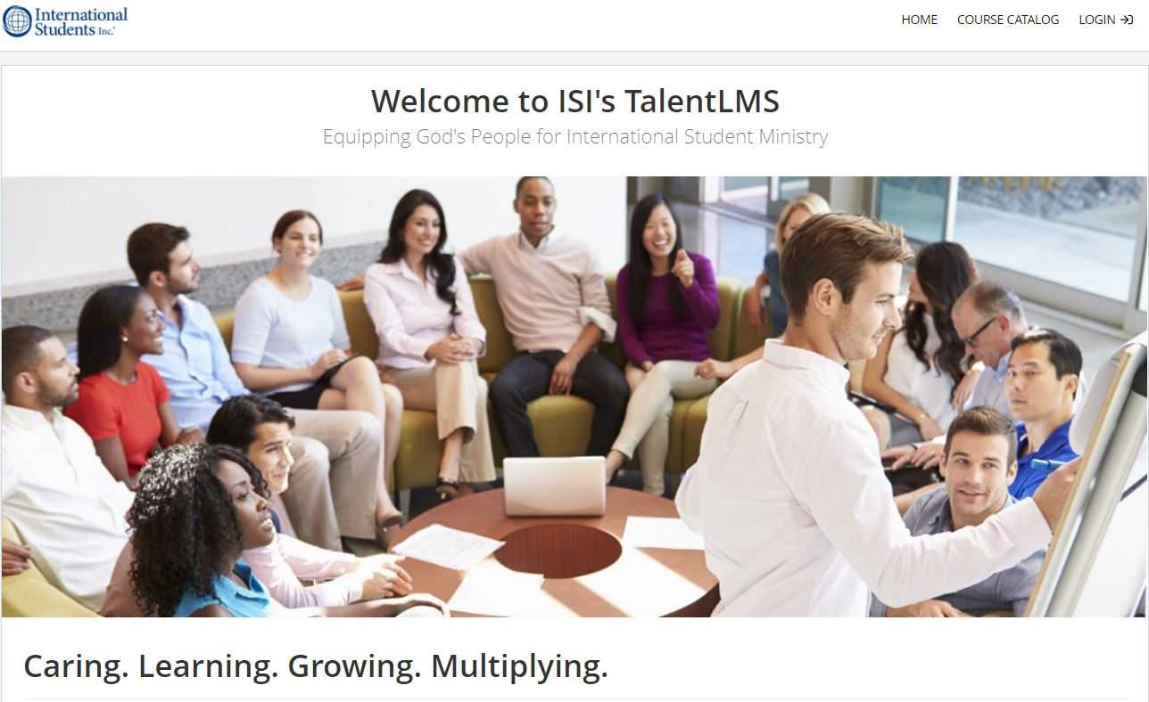
Talentlms
TalentLMS (Learning Management
System) has launched!
GET ON BOARD!

Slide 11
Talentlms goal
Provide ISI Staff, Students, Volunteers, and Partnering Churches/ Ministries with the tools, resources, and equipping needed to effectively accomplish their role in reaching and equipping international students to be disciple-makers wherever God places them.

Slide 12
Talentlms courses
WHAT YOU GET:
Unlimited access to courses/modules
Your personal development tracking
Special coach-directed modules
Group learning experiences
Progress reports and incentives

Slide 13
Questions? Input? gdecker@isionline.org teem: Valerie althouse, ron Bunyard, teri crowell, mike cutler, julie rhine

