Slide 1
Building resilient marriages:
10 Choices successful couples make
International Students Inc.
June 28, 2021

Slide 2
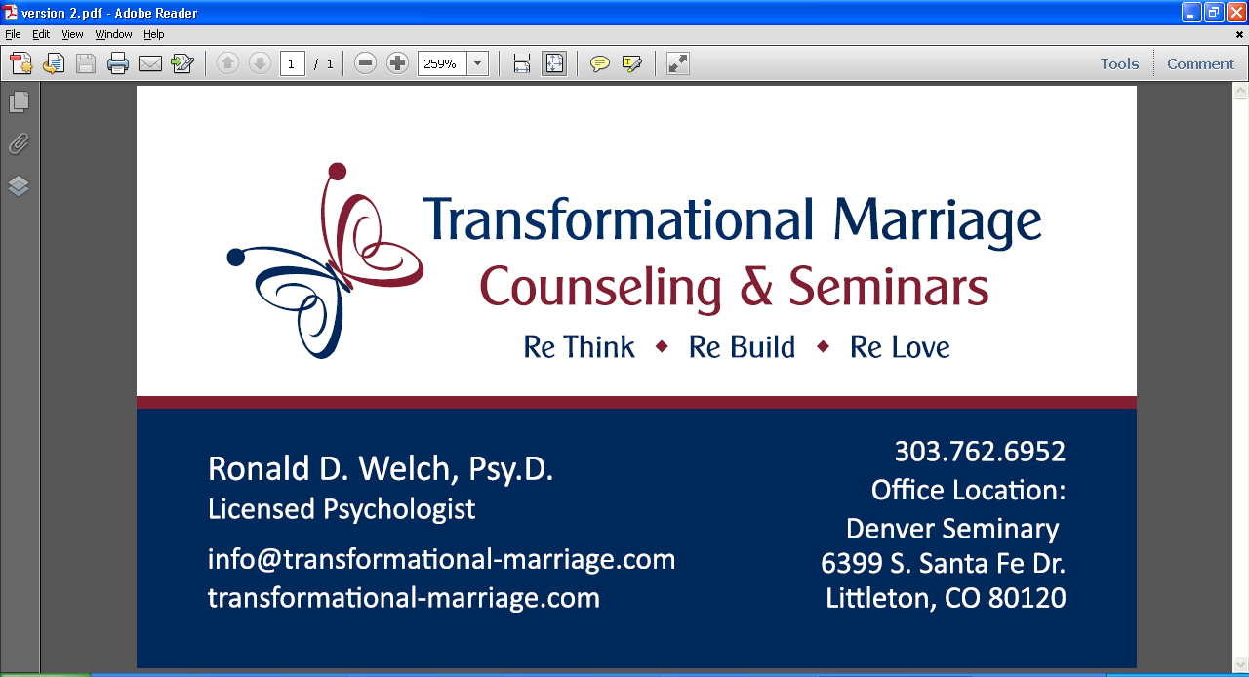
1) Requests for information may be sent to:
ron.welch@denverseminary.edu
help@transformational-marriage.com
2) All information not otherwise credited is copyrighted by
Ronald D. Welch and Transformational Marriage TM
transformational-marriage.com

Slide 3

Transforming a marriage starts with the choices you make

Slide 4
I Choose Hope
The first step in change is to believe that change is possible
When a spouse feels powerloess, they lose hope

Slide 5

GOD’S WORD ON CHOOSING HOPE
“For I know the plans I have for you,” declares the Lord, “plans to prosper you and not to harm you, plans to give you hope and a future”. Jeremiah 29:11

Slide 6
The Challenge of Hope
FAILURE
EXPECTING TO BE HURT AGAIN
“Fool me once, shame on you; Fool me twice, shame on me”
When the past has been full of failure, the bar is set pretty low
HOPE LEADS TO CHANGE
Hope is an important factor in couples who are able to change in marital therapy (Ripley & Worthington, 2002)
Learning to expect your spouse to succeed after failure is REALLY hard

Slide 7

NIAGARA FALLS METAPHOR

Slide 8
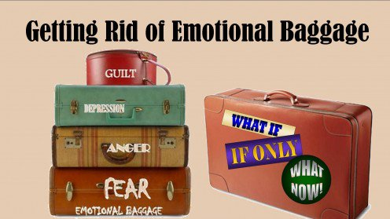
I Choose to Let Go
of old baggage

Slide 9
How Can you let go of the past?
Jan’s Story
Letting go of childhood experiences

Slide 10
Learned Helplessness
Example from Seligman dog experiments
Dogs learned that they could not avoid an electrical shock
So, they gave up and didn’t even try; just laid down and whined
What learned helplessness looks like in humans
When you try to change something in your marriage over and over, and it doesn’t work, you sometimes give up trying
It’s hard to expect success when you have failed before

Slide 11
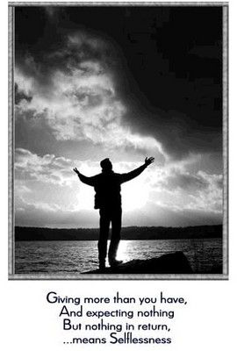
I choose to be UNSELFISH

Slide 12

Our story:
Transforming
Power and control
in marriage

Slide 13
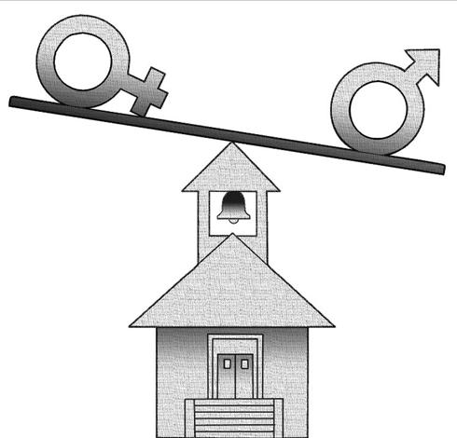
Power and Control
in Marriage
How do decisions get made in marriages?
When partners disagree, who gets their way?

Slide 14
TWO MODELS OF MARRIAGE
Self-focused Model (I need to get my needs met)
vs.
Other-focused Model (I need to focus on helping meet my partner’s needs)

Slide 15

GOD’S WORD ON CHOOSING UNSELFISHNESS AND SACRIFICE
Ephesians 5:22 – 25 22 Wives, submit to your husbands as to the Lord.
23 For the husband is the head of the wife as Christ is the head of the church, his body, of which he is the Savior.
24 Now as the church submits to Christ, so also wives should submit to their husbands in everything.
25 Husbands, love your wives, just as Christ loved the church and gave himself up for her… (NIV)

Slide 16
Why Do less powerful partners Allow Control?
1) Fear of Anger
What will happen if my spouse gets mad?
2) Learned Helplessness
It’s not worth the fight…
3) Unhealthy Submission in Faith-Based Couples
Headship/Submission Issues

Slide 17


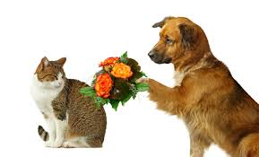
I choose FORGIVENESS

Slide 18
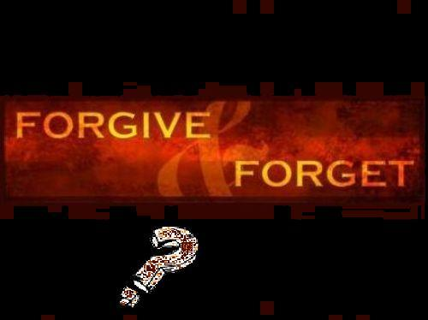
GOD’s WORD ON CHOOSiNG TO forgive
Then Peter came to Jesus and asked, “Lord, how many times shall I forgive my brother or sister who sins against me? Up to seven times?”
Jesus answered, “I tell you, not seven times, but seventy-seven times.
Mathew 12:12-22

Slide 19
What Forgiveness is Not…
“I can’t let this go…”
I don’t trust you
“I forgive you, but I won’t forget”…
I’m keeping a scorecard
“That’s just who you are…”
I don’t think you can change

Slide 20
What Forgiveness Is…
My Definition
Treating the person who wronged you as if he or she never wronged you
I think this is a Biblically based definition based on Christ’s example
This is what truly “letting go” feels like

Slide 21
Why Forgiveness is Hard
You have to give up your power
You have to accept that forgiveness is not fair
You have to choose to help your partner change

Slide 22

I Choose to challenge unspoken truths

Slide 23
Unspoken Truths
Over the years, I have realized that couples develop unspoken truths based on assumptions they make about each other.
These beliefs form the basis for how you act towards each other and drive much of what happens in the relationship.
Once you begin to accept those beliefs as “givens” in the relationship, they become the building blocks for your understanding of each other.

Slide 24
Examples of “Unspoken Truths”
He is just lazy.
No matter what I do, she’ll never really love me.
I don’t care what he says, I know my husband, and he will always be a cheater.
I know she had a rough childhood, so it’s not her fault if she gives up on us.
He says he works all those hours for us, but I think it’s really to prove something to himself.
She listens to her mom so much that I think she trusts her more than me.
I think he likes the idea of marriage, but just not the reality of being married to me.

Slide 25
I choose not to take you for Granted
Question:
  Why do we often treat our partners worse than we treat strangers on the street?

Slide 26

GOD’S WORD ON TAKING THINGS FOR GRANTED
Hebrews 13:16 The Message (MSG)
Make sure you don’t take things for granted and go slack in working for the common good; share what you have with others. God takes particular pleasure in acts of worship—a different kind of “sacrifice”—that take place in the kitchen and workplace and on the streets.

Slide 27
Schedule Time for Each Other FIRST – Not Last
Weekly Meeting #1 – The “Schedule” Meeting
Sit down together as a couple one night each week for a “Schedule” meeting.
Find a time that works for both of you.
Many of the couples I work with choose Sunday evening as it prepares them for the week.
During this meeting, look over your schedule for the week.
Weekly Meeting #2 – The “Check In” Meeting
This is a time where you can share any concerns or problems that either of you have that you might not be able to bring up at any other time.
That way, instead of feeling forced to bring up an issue at 11:30 at night, you have a time reserve to talk to each other.
Often, an hour is more than enough time, as you don’t have to solve all the problems; you just need a time to bring them up in a safe, healthy environment.
Weekly Meeting #3 – The “Date” Meeting
This does not have to be a four hour block of time when you can take a carriage ride and have a candlelight dinner
Any type of quality time together will work well
I suggest you take turns planning this time each week

Slide 28
I choose to communicate well
THE PROBLEM:
Studies have shown that the average married couple spends only about
? minutes/hours per hour
in serious discussion.

Slide 29
The Unfortunate Answer…
The average couple spends only about
6 minutes per WEEK
in serious discussion.

Slide 30
The ABCs of Transformational Communication
Accuracy, Brevity, Clarity, and Delivery
Over my years working with couples, I have discovered four secrets to communicating well. These four elements are:
Active Listening – Listening well and verifying the message
Brevity – Speaking in brief bullet points
Clarity – Making clear, easy to understand statements
Delivery – The tone and attitude you deliver the message with

Slide 31
10 Rules for Positive Communication
Rule 1: Don’t Bring Up the Past
Rule 2: Deal with One Conflict at a Time
Rule 3: Don’t Deal with Problems Late at Night
Rule 4: Don’t Deal with Problems When Short on Time
Rule 5: Tell the Truth; Hiding Things Doesn’t Help
Rule 6: Don’t Hit below the Belt
Rule 7: Focus On What Will Work in the Future instead of What Went Wrong in the Past
Rule 8: Listen More Than You Talk
Rule 9: Use Bullet Points
Rule 10: Avoid Destructive, Hurtful Statements

Slide 32
CHOOSING PROCESS OVER CONTENT
Content is…
      Specifics of the situation
      The issue that is being discussed
      Information and details
Process is…
      The way partners treat each other
      The way each partner feels after the encounter
      The patterns that develop between couples

Slide 33

I Choose to trust
Love is patient, love is kind. It does not envy, it does not boast, it is not proud. It does not dishonor others, it is not self-seeking, it is not easily angered, it keeps no record of wrongs. 1 Corinthians 13: 4-5

Slide 34
The 4 Building Blocks of Trust
Honesty
Integrity
Reliability
Vulnerability

Slide 35

I Choose to praise
Therefore encourage one another and build up one another
1 Thessalonians 5:11

Slide 36
Researchers tell us that for every negative thing we hear, we need to hear seven positive things in return
How many times this week have you told your partner what he or she did WRONG?
How many times have you told your partner what he or she did RIGHT this week?
God calls us to BUILD UP the person we marry instead of tearing them down!

Slide 37
Instilling Praise in a Controlling Relationship
Gottman’s (2000) 4 Horsemen
1) Criticism
2) Contempt
3) Defensiveness
4) Stonewalling
Counselors and Pastors can help couples replace these with positive reinforcement

Slide 38

I Choose intimacy
Submit to one another out of reverence for Christ.
Ephesians 5:21

Slide 39
The Definition of Intimacy
Rosenblat and Wieling (2013) define intimacy as a desire and motivation to know each other and be vulnerable enough to share yourself with each other.
They describe this as including investing time in learning how each other works, developing relationship rules, and having accountability, safety, and devotion to knowing and being known

Slide 40
INTIMACY EXERCISE: Remembering the Good Times
To build hope in a relationship, couples often have to create a “soft bed to land on” when the normal valleys in a relationship occur.
That means remembering when you were dating, fell in love, the wedding, the honeymoon, and all the other good memories that your relationship includes.
I am making an assumption that the honeymoon was actually a great memory for most of you, although I know that is not always the case.
In our marriage, Jan and I still celebrate our anniversary every month, even after 30 years.
It’s our way of reminding ourselves more than once a year how glad we are that we found each other. The many great memories and “inside stories” that we have give us a “soft bed” that we can land on when we have conflict.
Years ago, we received some small Chick Fil A cows in one of their promotions. We leave them in suitcases, under pillows, in cars, and all over the place to say “I Love You”

Slide 41

Two
closing
thoughts…
1. You never marry the person you marry: he or she is always growing and changing.
Love is allowing your spouse to surprise and astound you, rather than disappoint you.
Iron sharpens iron… the experience of marriage is a two-way street and both partners must own their part and be willing to change.
2.Husbands and wives can help each other transform.

Slide 42
1) Requests for information may be sent to:
ron.welch@denverseminary.edu
help@transformational-marriage.com
2) All information not otherwise credited is copyrighted by
Ronald D. Welch and Transformational Marriage TM
transformational-marriage.com

