Slide 1
ISI & MOPS ministry partnership

Slide 2
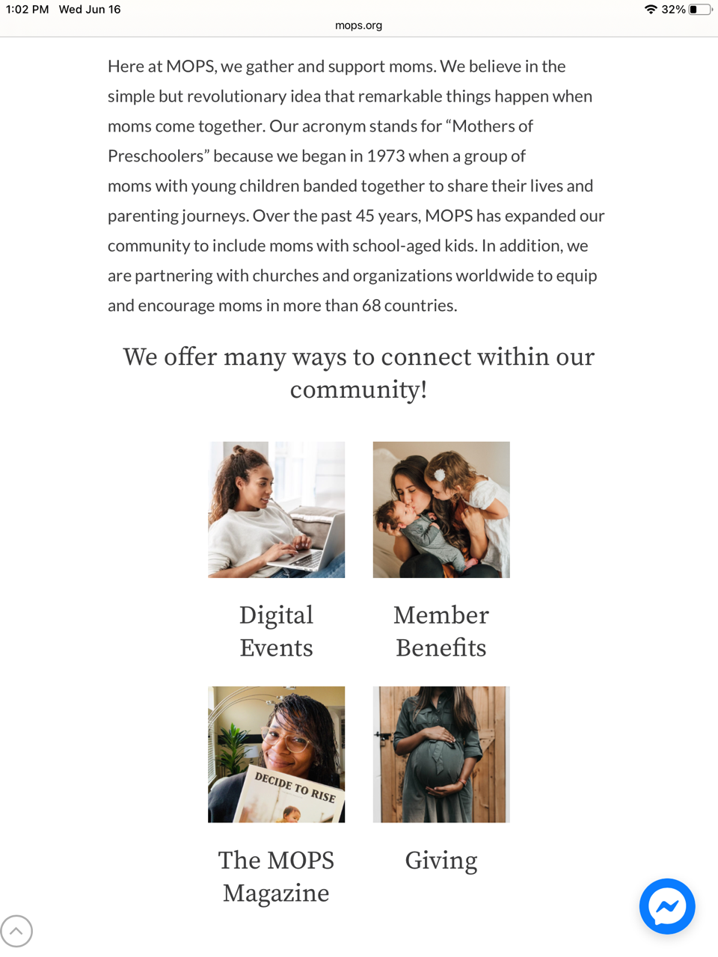
MOPS = Mothers of Preschoolers began in 1973 expanded to include moms with school-aged children
MOPS International mops.org
has been building communities of moms for over 45 years, connecting women all over the world to each other and Jesus while embracing the journey of motherhood together
encourages and equips moms of young children to realize their potential as mothers, women and leaders, in relationship with Jesus and in partnership with the local church

Slide 3
Mama meetups
a new way for moms to be a part of the MOPS community
women from across the globe come together to create unique, supportive communities for a specific group of women (ISI moms, international moms)
MOPS provides everything you need to know about leading an online group from video conferencing tools, Facebook pages, discussion questions, etc.
Support staff to help with questions

Slide 4
ISI MOPS online community
ISI staff (spouse or volunteers) with children under the age of 12
MOPS (Mothers of Preschoolers)
MOMSNEXT (moms with elementary age children)
Basic membership ($28 per year with promo code ISISTAFF) includes:
✓ Access to all Digital Series by MOPS International ✓ Comeback Tour Digital Workbook ✓ Quarterly print Magazine subscription ✓ Access to local, in-person MOPS groups ✓ Bi-monthly encouraging texts ✓ Monthly Virtual Prayer Gathering ✓ Tuition discount up to 30% at Colorado Christian University
http://www.mops.org/join (ISI Group ID P864)

Slide 5
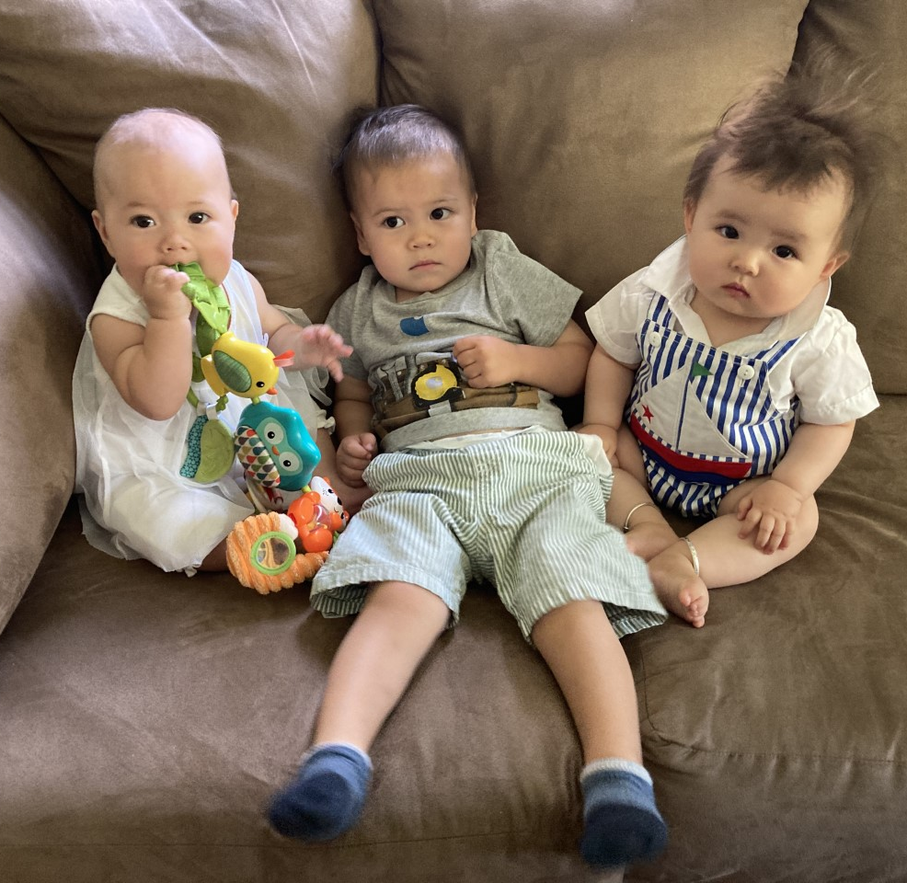
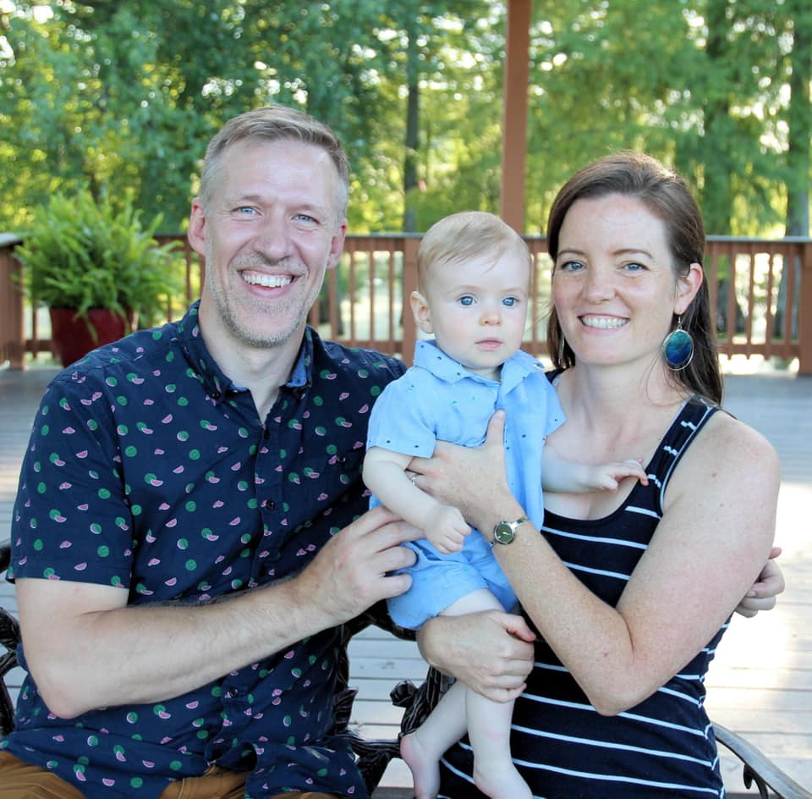
From one of our ISI moms
I so enjoyed being able to talk to others who are not only moms but moms in ministry! Getting to learn more about how they navigate the challenges of motherhood along with the complexities of serving students and how to juggle all those things was very helpful to me as I'm figuring all this out for the first time! 🙂
Also, I didn't really have other moms around me during COVID so it was also helpful to talk intentionally about the topics- giving yourself grace in parenting, finding dignity in your motherhood, etc. These are not topics that just naturally come up in most conversations! It’s good to have this space to discuss these things together and also to pray for each other!

Slide 6
Outreach to international moms
ISI MOPS leaders (MOPS members who have completed the 2-hour video training)
access to multiple leadership resources and curriculum
or
coordinate a MOPS group of international moms and local volunteers to meet in someone’s home
video presentations easily used to prepare and direct discussions
“mama meetups” connect online with international moms
theme-based topics interesting and applicable for all moms

Slide 7
Partnering with a local church with an existing MOPS group
ISI staff connect with a local church MOPS group to engage international moms within their outreach
MOPS moms + older staff/volunteers (mentor moms, coordinators, hospitality, small group leaders)
another opportunity to connect campus ministry with local churches

Slide 8
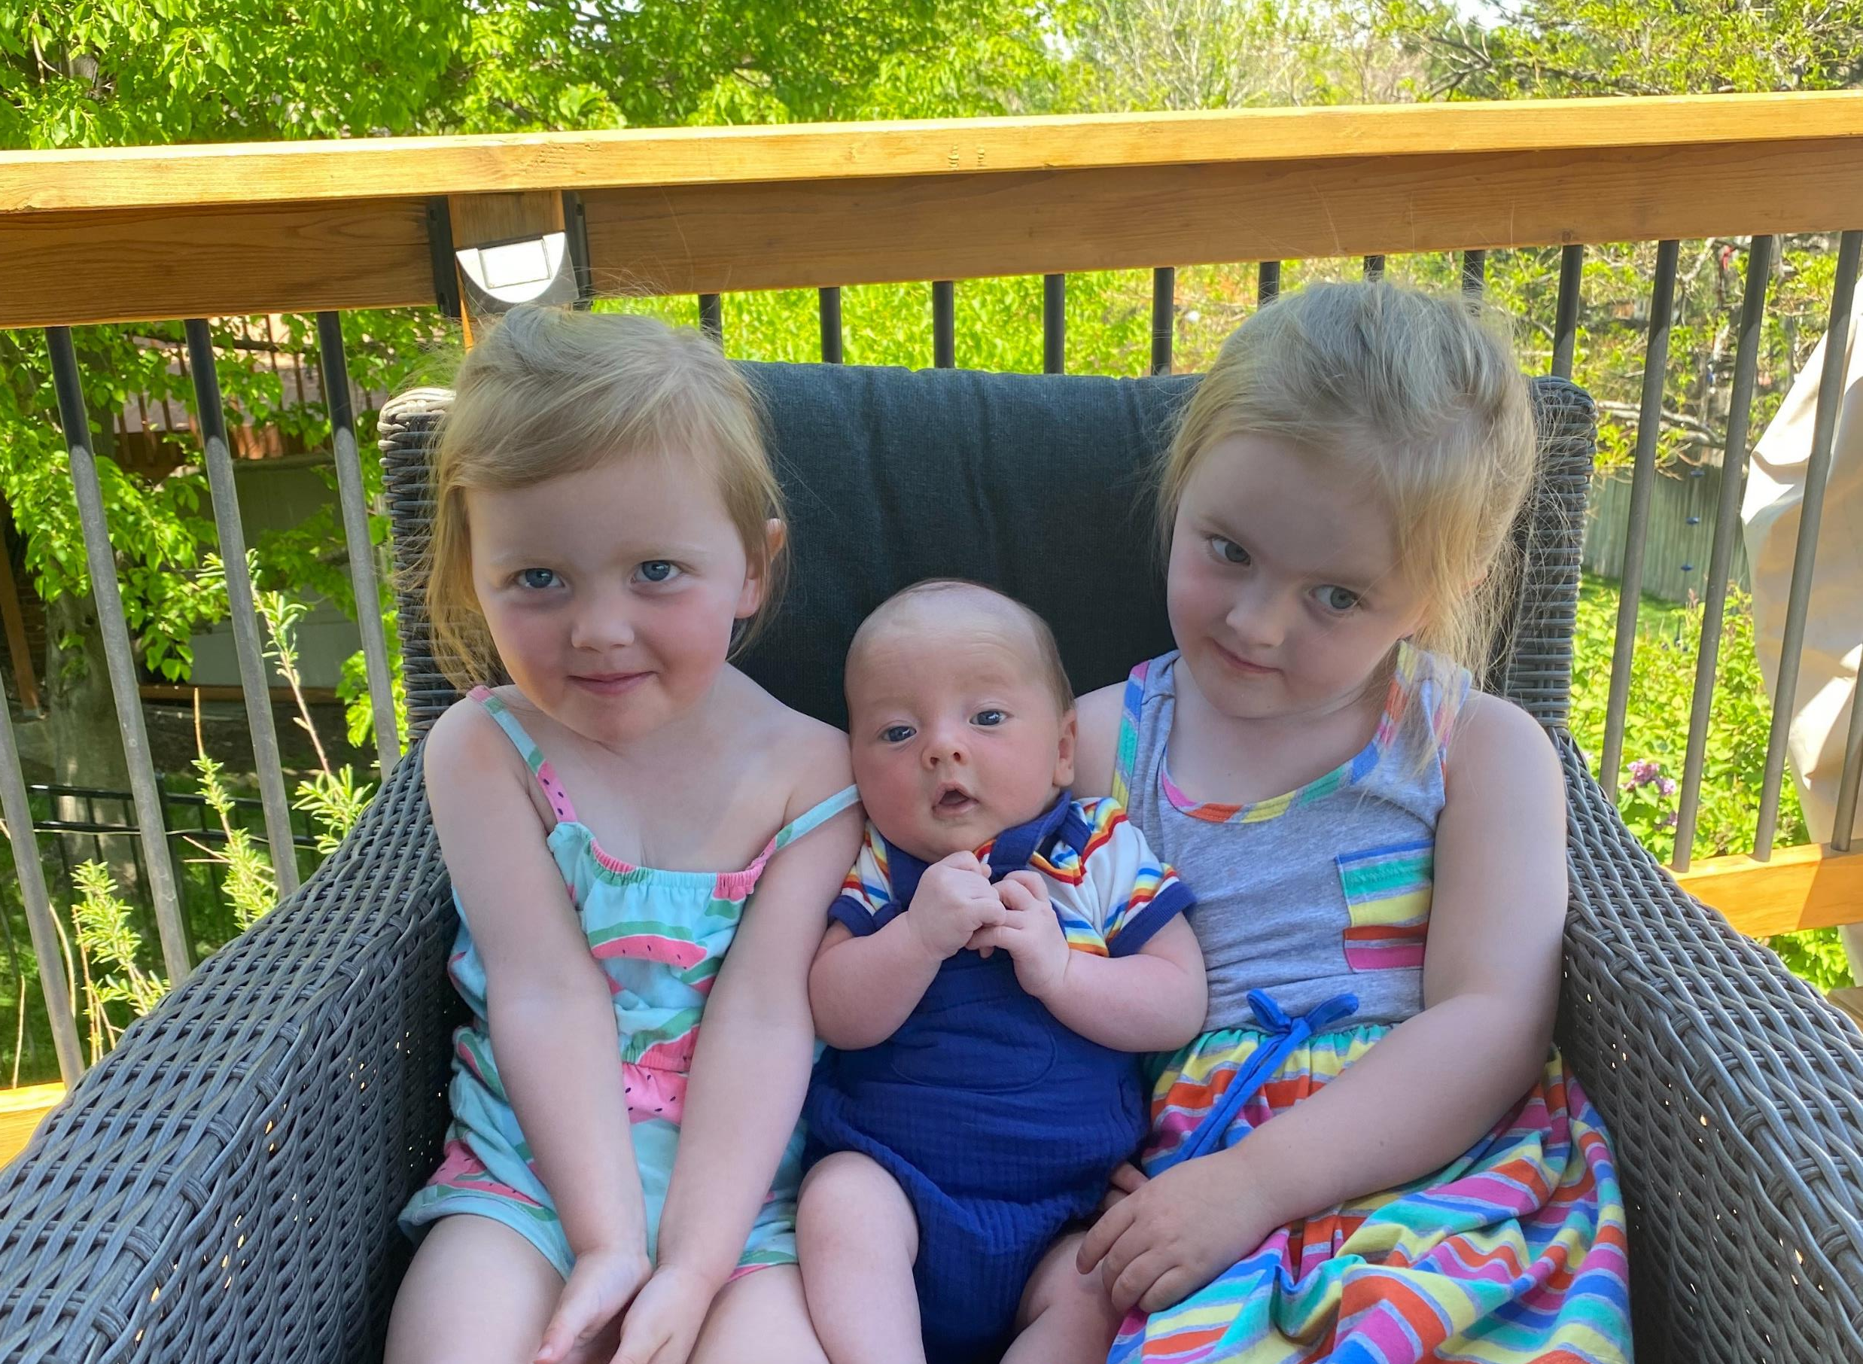
International moms as MOPS members
MOPS has provided a promo code (ISISTUD) which covers 50% of the membership fee
scholarships available through ISI or MOPS
When students are transitioning to a new location, in the US or abroad, their memberships go with them!
Global MOPS has grown internationally with groups now in 71 countries and its materials have been translated into several languages.

Slide 9
Sherri Crandall, VP of Global Ministries and Leadership Experience sherricrandall.com mops.org
Basic membership=$28/yr (promo code: ISISTAFF) ISI moms Group ID P864 INTERNATIONAL MOMS 50% DISCOUNT ON MEMBERSHIP (ISISTUD)

