Slide 1
MINISTRY MODELS & FUNNEL DIAGRAM
DAVID LARSON
NATIONAL CONFERENCE WORKSHOP JUNE 2021

Slide 3
Ministry Milestones samples
CATEGORY | Ministry #1 | Ministry #2 | Ministry #3 | Ministry #4
INTRODUCING | 577 | 760 | 500 | 316
CULTIVATING | 158 | 295 | 215 | 167
DISCIPLING | 20 | 85 | 46 | 89
DECISIONS | 0 | 2 | 0 | 6
US REPRODUCING | 0 | 1 | 5 | 9
REPRODUCING | 0 | 0 | 12 | 6

Slide 4
Baseball Diamond Illustration
Decision
Discipling/
Mentoring
Bible Study
We count what we value.
Don’t forget to count reproducers
On Deck Circle
Reproducers
Cultivating
Introducing

Slide 5
MEASURING REPRODUCING IMPACT
In 2012 I devised a measure of reproducing impact called TRI and over the next 8 years analyzed milestone data of Northeast ministries according to ministry model and TRI.
Total Reproducing Impact (TRI) is a measure of the reproducing impact of a ministry over time.
Whenever a reproducer is reported, an entry is made into the city reproducer list and a value 1,2 or 5 is assigned.
The reproducing level of each reproducer should be verified and updated every two years.
Decision to Reproducer (DTR) is someone who came to Christ through the ministry and went on to become a reproducer.
Show Ithaca Reproducers list as sample.

Slide 6
CASE STUDY Wichit & Miriam Maneevone

Slide 7
Hybrid Model: ICF & FPs
DBS
English
Classes
FPs
ICF
South Asian ministry
Events & Trips
MOT

Slide 8
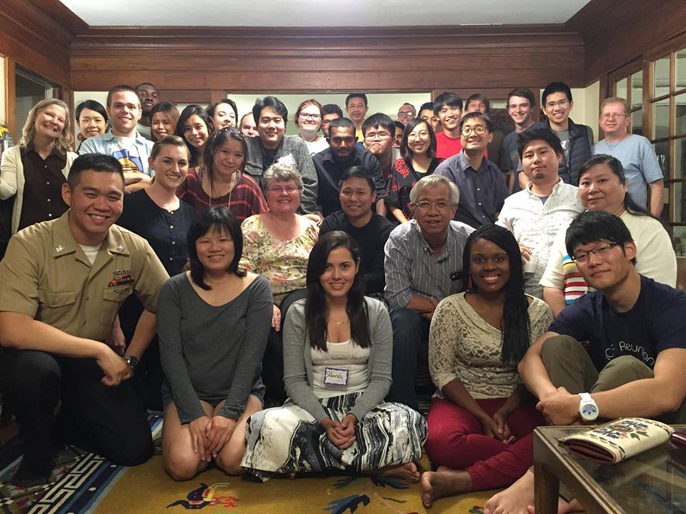
TYPES OF ICF MODELS
1) Traditional
Christian student leadership team
Separate Bible study groups for seekers & Christians
Ideally 20 – 50% seekers
2) Seeker
Mostly seekers and American volunteers. Not called ICF.
One talk with small group discussions.

Slide 9
TYPES OF ICF MODELS
3) Hybrid
Large group meeting geared to seekers
Christian student leadership with Discipleship Group on separate evening
4) Mini-ICF / Home Fellowships
Multiple in one city
Hosted by American families in their homes
Seeker oriented
5) Church Based
Park Street Church (PSIF)
LA Church based model—hosted by volunteers from one church for one campus; twice a month

Slide 10
Scriptures
1) Christ’s desire and our goal should be fruit that will last. John 15:16
2) Christian community has drawing power for seekers. John 17:23.
Reproducing Impact will not consistently
happen without Discipleship

Slide 11
QUESTIONS

