Slide 1
Instagram Exploring
Meeting students when you can’t meet in person

Slide 2
Why Instagram?
Gen Z (13-21 year olds) primarily use Instagram, Snapchat, and YouTube. Facebook is a distant fourth place, as usage in this age range has dropped.
The only social network that's growing among young Americans is Instagram, up from 64% to 66% in the past two years.
Most Instagram users are between 18 to 29 years of age with 32% of Instagram users being college students.
“If your target demographic is under 35, Instagram is a gold mine: 63% of users are between the ages of 18 to 34, with virtually even split between male and female users.”
Sources: https://www.businessinsider.com/gen-z-loves-snapchat-instagram-and-youtube-social-media-2019-6; https://dustinstout.com/social-media-statistics/, https://www.convinceandconvert.com/social-media-research/social-media-usage-statistics/, https://sproutsocial.com/insights/new-social-media-demographics/#IG-demos, https://www.searchenginejournal.com/social-media/biggest-social-media-sites/#close

Slide 3
Input from students…
A student from Nigeria: “Back home Instagram is pretty big. Actually among the youths, no one really uses Facebook so much, it’s largely Instagram. I don’t know if WhatsApp counts as social media rather than messaging, but if it counts then WhatsApp is the biggest. Instagram and Twitter are probably next.”
Of the students in my ministry who are active on social media, the vast majority told me that they started using Instagram before coming to the US, and with regards to social media, they use Instagram and WhatsApp the most. Those who said they use Facebook more are over 30 and/or have been in the US for at least five years.

Slide 4
Why does this matter now?
Many of us are turning to digital ministry. Many campuses are still not fully open. To be effective, we need to be where students are – and for many, this is Instagram.
This is a way to meet students you might not normally meet in person.
While the functionality is very different from Facebook, it actually provides unique opportunities to find and reach out to students.
This kind of outreach is a great opportunity to engage students and volunteers who are proficient with Instagram. (You don’t necessarily have to be the one to do this! Or, take this as an opportunity to let students teach you something new, if Instagram is new for you.)

Slide 5
What is Instagram Exploring?
Essentially, we are using Instagram to find students we haven’t met before.
Think of it as doing tabling or evangelism on campus. You try to talk to a lot of students, actually talk to some, and hopefully, prayerfully, really connect with a few.
This is most effective as an all-hands-on-deck activity. Recruit help, stay organized, communicate, and encourage one another in order to meet as many students as possible.

Slide 6
How do you do it?
Set up your Instagram. Make sure your profile looks clean, informative, and up to date.
Open Instagram, preferably on your desktop.
Find Instagram pages where international students will be. For example, search “Sac State international students.” You might also ask students about pages they know.
Click on the “Followers” list to find the students following this page. Click on student profiles (recommend opening them in a new tab) and take your best guess if they might be an international student, or even a Christian. Look for country flags, foreign languages, Bible verses, crosses, etc.

Slide 7
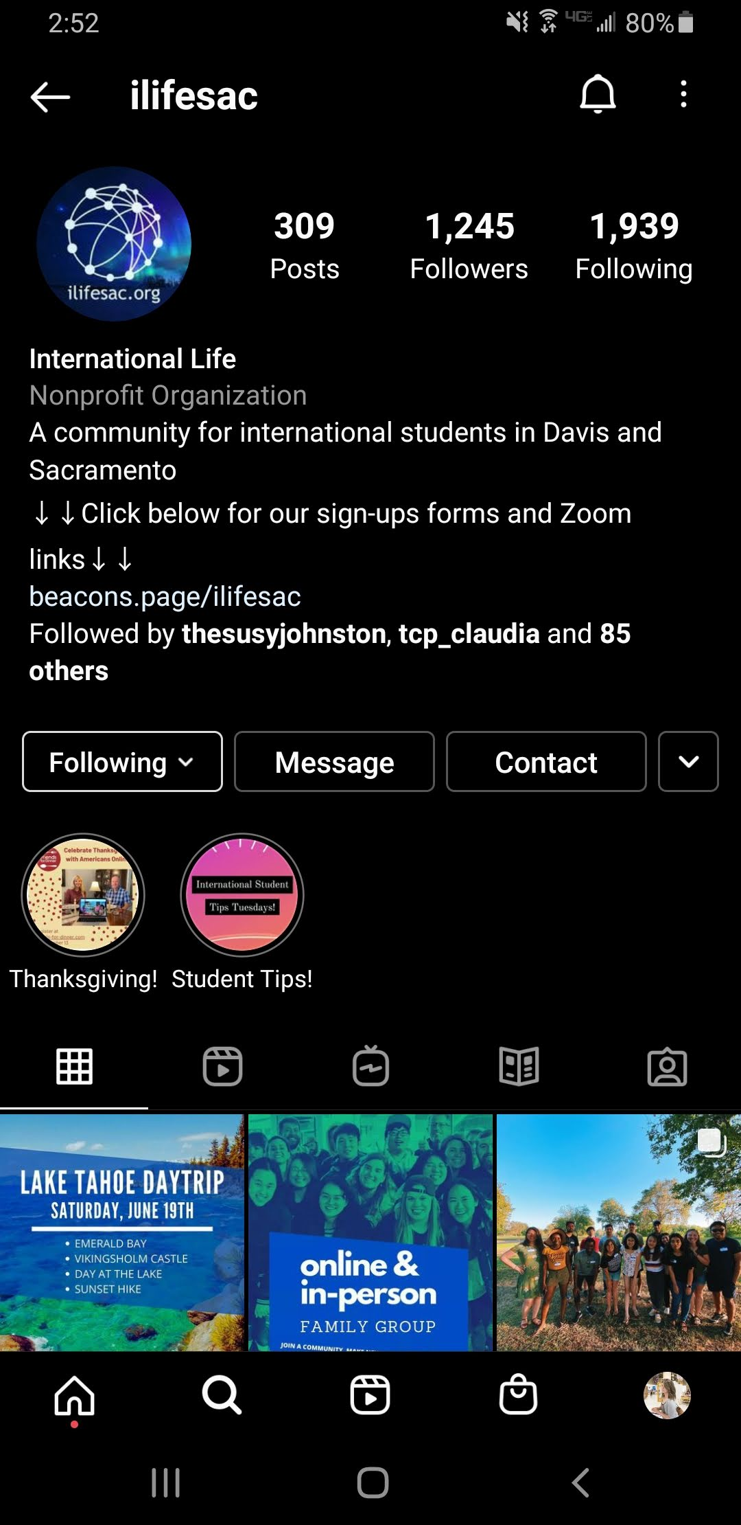
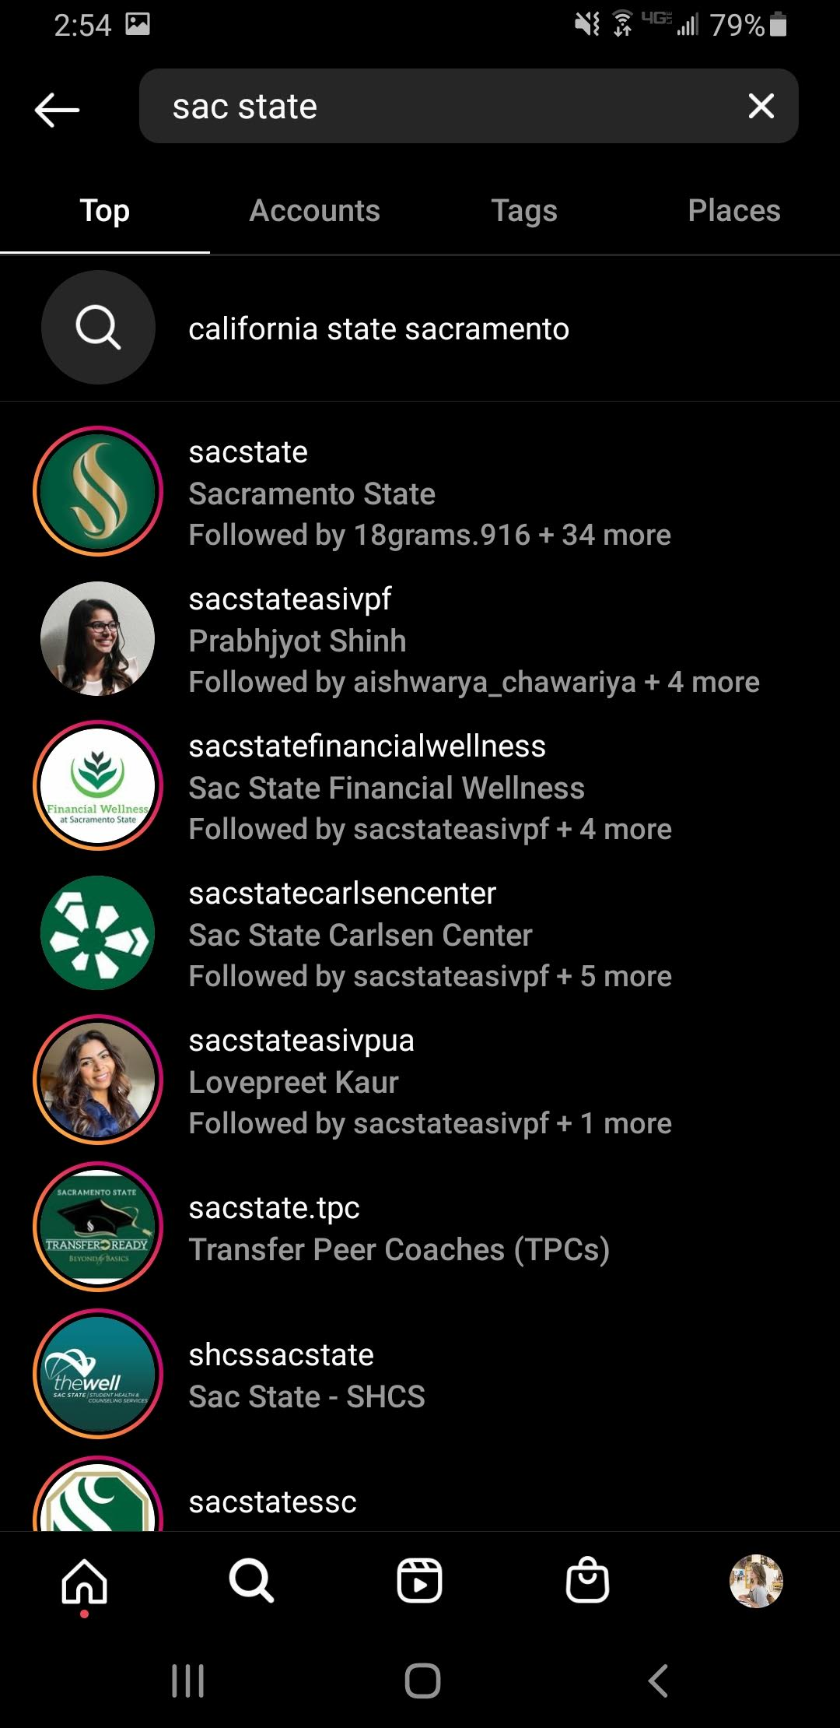

Slide 8
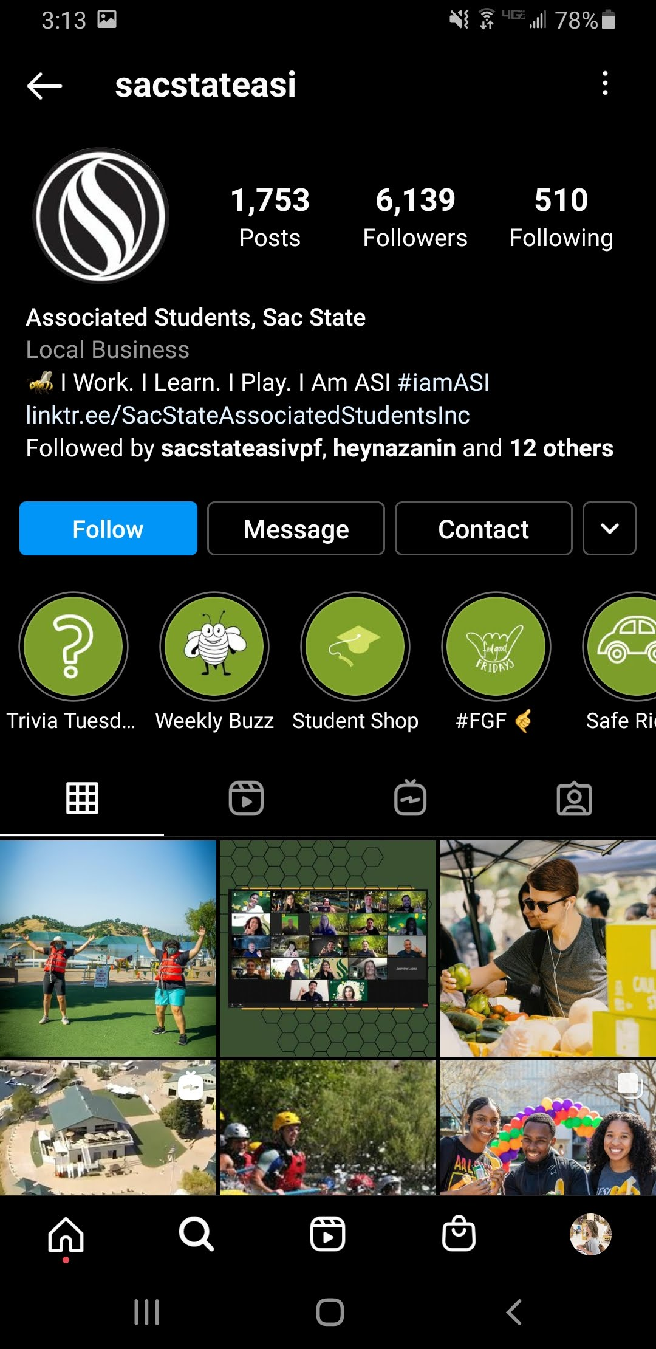
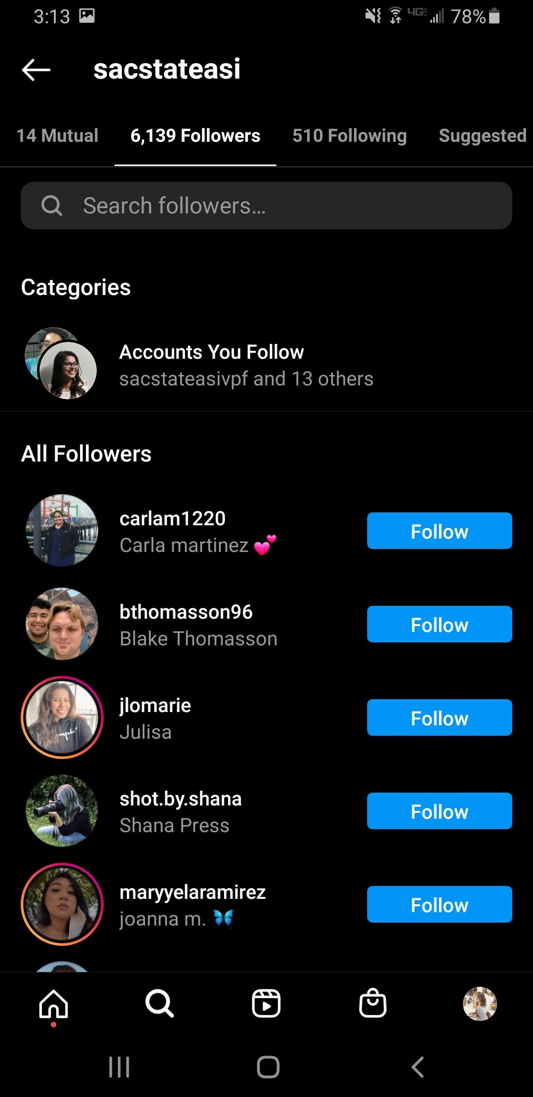

Slide 9
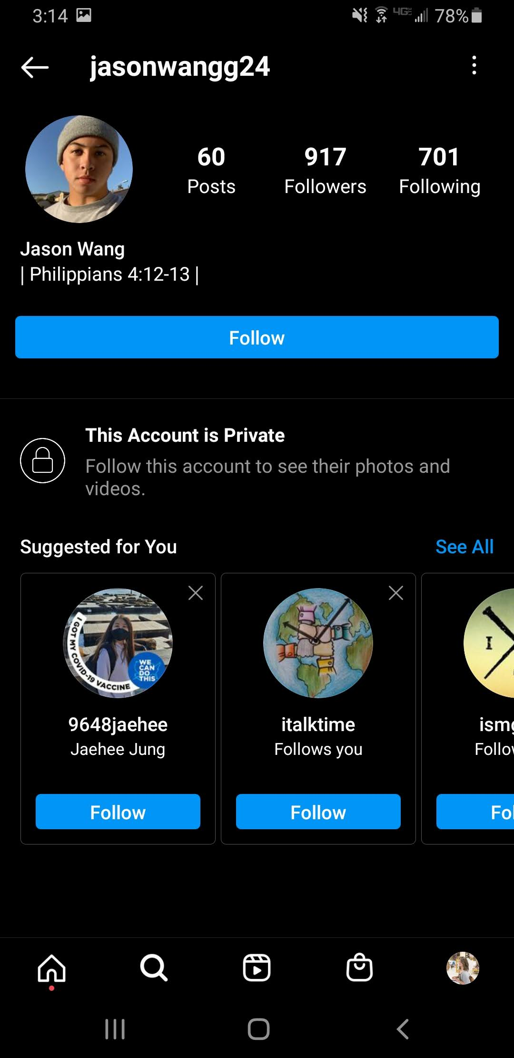
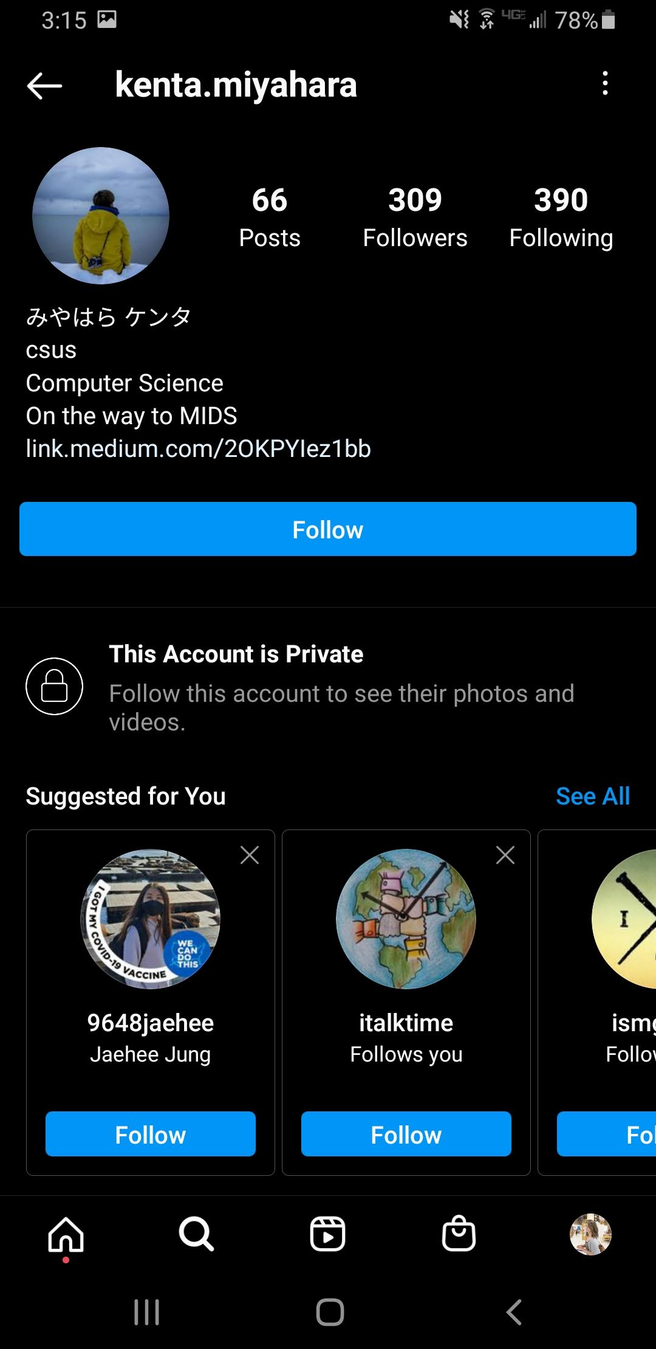

Slide 10
Follow them to send them a message. Or if their account is set to private, send them a follow request, then send a message if they accept it. Have men message men and women message women.
Example message: “Hi____. My name is___ and I’m with a group called International Life in Sacramento. We are a group started by Christians to help international students in every area of their lives. We want to be available for students like yourself to help with any needs you may have. This includes our online community and opportunities to make new friends. I understand for international students, going into this next year online during a pandemic is tough. How are you doing with that? It would be great to hear from you.”

Slide 11
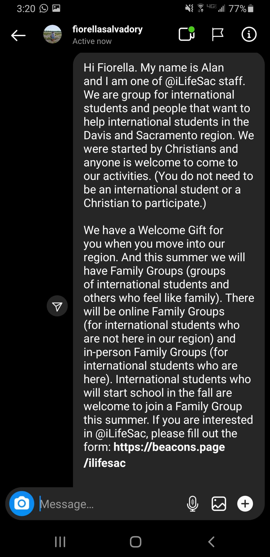

Slide 12
If the student responds, keep a conversation going. Tell them about your group in more detail, encourage them to follow your social media, invite them to something, or even arrange an in-person or virtual meetup. (You can video chat in Instagram.)
If the student says no thank you, you can still encourage them to follow your social media.
If the student is not an international student, encourage them to tell any international students they meet about our group. Perhaps in your initial message, you can add a line about, “Are you an international student, or do you know international students?”

Slide 13
Keep track of the students you actually message (not just the ones you send a follow request to) on a spreadsheet. Keep track of the student’s name (or Instagram handle), gender, the person who sent the message, whether you received a response, and any additional notes (what kind of conversation was had, if the student asked for any resources, etc). If you are doing this for multiple campuses, have a tab for each campus.

Slide 14
Other ideas for Instagram
Make a ministry Instagram account if you don’t already have one
Learn to use it well, or recruit help (maybe a team) to do it. Consider using this account to do Instagram Exploring, especially since students might follow you back and see all of your posts!
Use a Linktree or Beacons page as your “bio link” (the one link you are allowed to put in your “bio”). This will allow you to link to other things, like event signups, Zoom links, and other resources.

Slide 15
Questions? Need more info?
Contact Amber Carpenter acarpenter@isionline.org
Or on Instagram ☺ @rilakkamber

