Slide 1
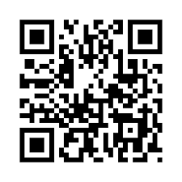
Connecting Before Arrival
* Leverage Campus Leadership and connect with consulates
* Seek Super Students / People of Peace and students’ Facebook groups
* Become a YouTuber or coordinate a team of YouTubers – Culture, Sites, Housing, Arrival Tips
Create a QR Code www.qr-code-generator.com
then Zoom / WhatsApp / Line / WeChat
and PRAY without ceasing! ☺

